Slide 1
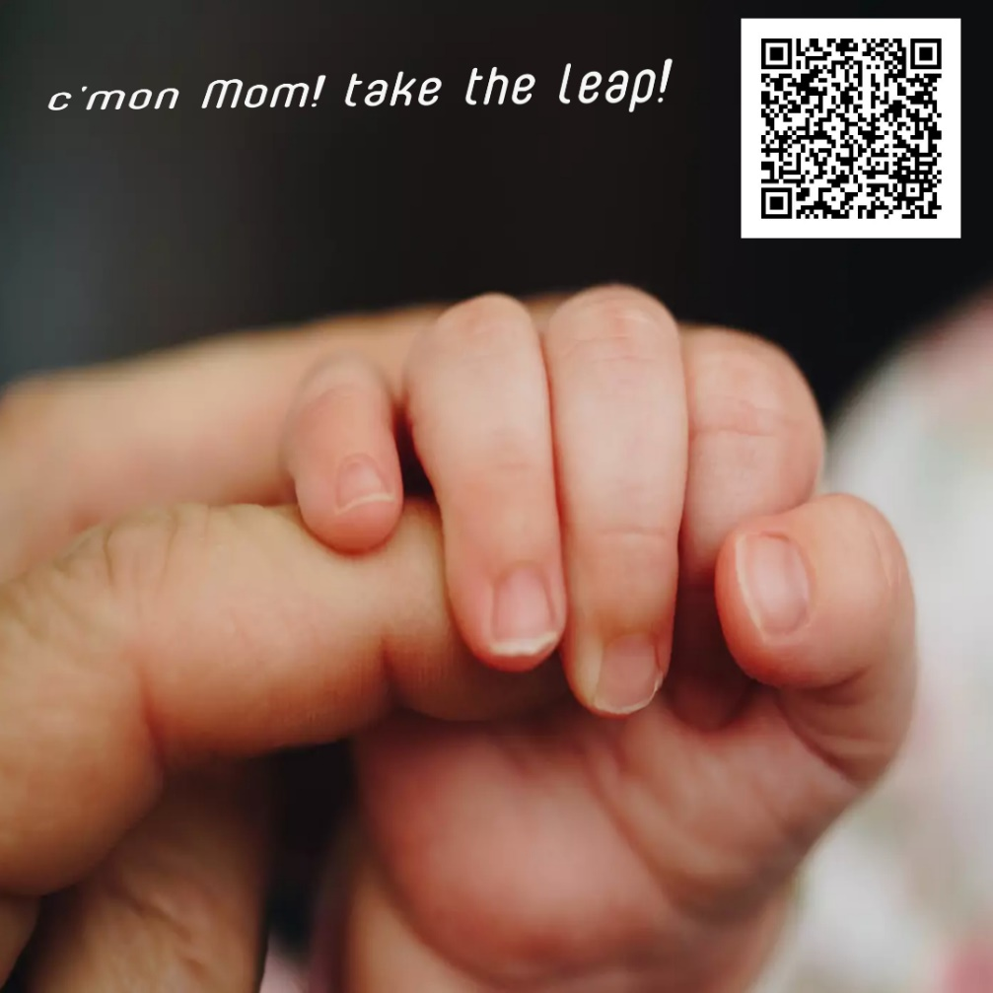
Facilitating access to diabetes prevention program for women with Gestational diabetes after delivery to prevent type 2 Diabetes.
Priyadharshini Narayanan, MD¹, Linda Hill, MD, MPH¹, Gladys Ramos, MD², Elizabeth Spooner, DNP, RN², Harmonie Strohl³,
¹UCSD Preventive Medicine and Public health, ²UCSD Obstetrics and Gynecology, ³UCSD Medical Student
Introduction
B. Building collaborations between local diabetes prevention program and UCSD
CDC Certified DPPs were contacted to gain information on program resources, referral requirements, cost and promote dedicated session for groups of women who are in the first year after delivery of a GDM pregnancy and provide more online classes.
Certified DPPs interested in collaboration include Skinny Gene, Family Health Centers of San Diego, Scripps Medical, San Yisidro Health, Case Specific Nutrition.
Information on CDC certified app based, self paced DPPs were also precured.
Next, meeting with obstetrics, primary care, and population health departments held and a workflow for referral to DPP was proposed.
C. Health communication and education
Meetings held with Certified Diabetes Educators (CDE) at UCSD and information provided on DPP.
An educational handout on DPP was developed for the diabetes educators to pass on to pregnant women at 36 weeks gestation.
A slide on DPP was added to the virtual GDM class PowerPoint that is routinely used for education for GDM patients.
A webpage information on all local and nationwide DPPs with their address, contact info, weblink, insurances accepted, availability of online group sessions, availability of bilingual programs, and information on self-paced programs, was developed.
The informational webpage will be captured in a QR code and provided to patients through MyChart message at the time of delivery or the 6-week post-partum visit.
Provide a steady, reiterating reminder for women after delivery of a GDM pregnancy to enroll in a National Diabetes prevention program when they are ready.
Gestational diabetes mellitus (GDM) that affects 2-10% of pregnancies in the United States is a harbinger of future GDM, type 2 Diabetes Mellitus, Hypertension, and cardiovascular disease.
1 in 3 women with GDM develop type 2 DM within 10 years after a GDM pregnancy. The odds of developing type 2 DM in the decade following GDM is 10-17 times as compared with no history of GDM.
Given the time lapse between GDM and development of type 2 DM, the risk is often forgotten or lost in the transition of healthcare from a women’s obstetric care to primary care.
For some women who are aware of this risk, the issue is not knowing where to find resources to help mitigate their risk of type 2 DM.
While evidence exists on the protective effects of weight loss, lifestyle changes are often intensive processes that require involvement in a program with skilled and certified educators such as Center for disease control and prevention’s (CDC) National Diabetes Prevention Program (DPP).
This QI project sought to address this issue by developing a pathway from delivery of a GDM pregnancy to enrollment in a DPP.
Proposed Pathway for Women with GDM to Enrolling in a DPP
Woman with GDM (followed by Ob until 6 weeks post-partum)
Information and Education (by NP during 1st class for GDM, handout emailed at 36 weeks pregnancy, reminder magnet provided at 6 week post-partum visit )
Woman returns to PCP/OBGYN for referral after a while
(check A1c and refer)
Woman requests immediate referral after delivery
(check OGTT and refer)
Referral placed to PHSO
If 1. eligible and 2. health insurance contracted with UCSD and 3. spot available at UCSD DPP, booked with UCSD DPP
If 1.health insurance not contracted with UCSD or 2. no spots available with UCSD DPP or 3. requests another program for convenience, place external referral
Woman chooses a DPP from the resources and self refers to programs that accept self referral/self pay/employer contract
Evaluation
Evaluation of this QI project will be through data gathered from collaborating DPPs. Quality measures will include 1. Referral rates from UCSD, 2. Enrolment rates, 3. rates of completion of at least 6 months in the program and, 4. rate of accomplishment of weight loss goals. The evaluations will be performed at 6 and 12 months.
References
1. Bernstein JA, Quinn E, Ameli O, et al. Follow-up after gestational diabetes: a fixable gap in women’s preventive healthcare. BMJ Open Diabetes Res Care. 2017;5(1):e000445. doi:10.1136/bmjdrc-2017-000445
2. Dennison RA, Fox RA, Ward RJ, Griffin SJ, Usher‐Smith JA. Women’s views on screening for Type 2 diabetes after gestational diabetes: a systematic review, qualitative synthesis and recommendations for increasing uptake. Diabet Med. 2020;37(1):29-43. doi:10.1111/dme.14081
3. Toft JH, Økland I, Risa CF. Gestational diabetes mellitus follow-up in Norwegian primary health care: a qualitative study. BJGP Open. Published online December 8, 2021:BJGPO.2021.0104. doi:10.3399/BJGPO.2021.0104
4. The Cost of Diabetes | ADA. Accessed September 27, 2022. https://diabetes.org/about-us/statistics/cost-diabetes
5. O’Reilly SL. Prevention of Diabetes after Gestational Diabetes: Better Translation of Nutrition and Lifestyle Messages Needed. Healthcare. 2014;2(4):468-491. doi:10.3390/healthcare2040468
6. 10-year follow-up of diabetes incidence and weight loss in the Diabetes Prevention Program Outcomes Study. Lancet. 2009;374(9702):1677-1686. doi:10.1016/S0140-6736(09)61457-4
7. Women’s Screening For Diabetes After Pregnancy - Recommendations | Women’s Preventive Services Initiative. Published October 2, 2018. Accessed September 27, 2022. https://www.womenspreventivehealth.org/recommendations/screening-for-diabetes-mellitus-after-pregnancy/
8. Nielsen KK, Kapur A, Damm P, de Courten M, Bygbjerg IC. From screening to postpartum follow-up – the determinants and barriers for gestational diabetes mellitus (GDM) services, a systematic review. BMC Pregnancy Childbirth. 2014;14(1):41. doi:10.1186/1471-2393-14-41
9. Balaji B, Ranjit Mohan A, Rajendra P, Mohan D, Ram U, Viswanathan M. Gestational Diabetes Mellitus Postpartum Follow-Up Testing: Challenges and Solutions. Can J Diabetes. 2019;43(8):641-646. doi:10.1016/j.jcjd.2019.04.011
Methods
The project was developed with a multifaceted approach to the issue and incorporates community involvement, multispecialty collaboration, and health communication.
Community Needs Assessment
Focus group interviews of women with history of GDM were conducted.
Results of Focus Group Study: 8 participants with diverse demographics.
One participant was currently pregnant with GDM and 7 had history of GDM within the past year. Four participants were currently working.
None of the women knew about the existence of the National Diabetes Prevention Program.
All of the women were interested in joining one or another format of the program.
Five of the eight women wanted to join group based DPP and three preferred self-paced, app-based DPP.
Majority of the women were willing to commit to the program for a year despite their work and childcare commitments.
Reasons for willingness to commit to the program as expressed by the women were “my health is important”, “need help with lifestyle changes”, “peer support from women with the same issues”.
The only barrier to committing to the program were “lack of time”. Women who reported ‘lack of time’ inclined towards committing if they could attend DPP during work hours
A magnet on fridge or car may be a good resource of reminder for these new mothers who have time constraints, competing priorities and other barriers to act and may also be a good source for quick access to information when they feel ready to act.

