Slide 1
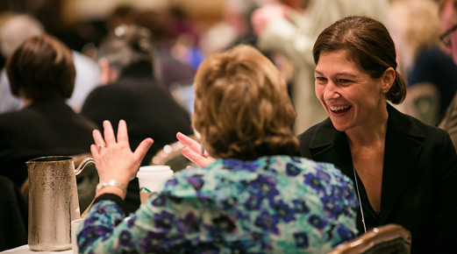
Preservation in a Dynamic Environment
A Librarian’s Perspective
Stephen Abrams
California Digital Library
University of California

Slide 2
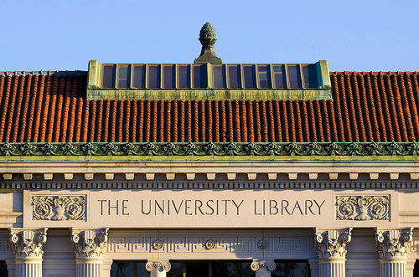
Changing conditions, unchanged commitment
www.flickr.com/photos/parksdh/7796326226
Connecting patrons with content of interest in meaningful ways
across barriers of space and time
Connecting patrons with content of interest in meaningful ways
across barriers of space and time
Notes:
Welcome back, D. H. Parks, http://www.flickr.com/photos/parksdh/7796326226

Slide 3
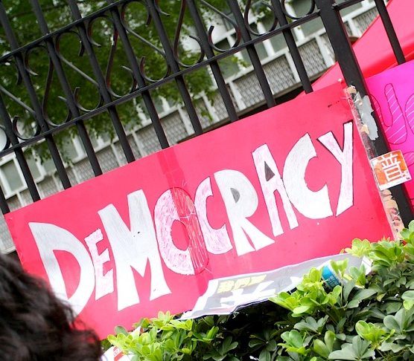
Changing face of patronship
www.flickr.com/photos/andystoll/926751229
Democratization of production
Loss of shared understanding
Notes:
Democracy, Andy Stoll, http://www.flickr.com/photos/andystoll/926751229

Slide 4
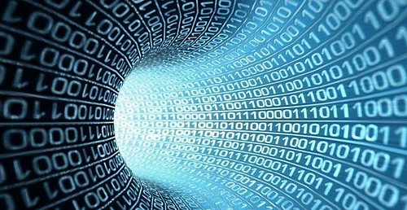
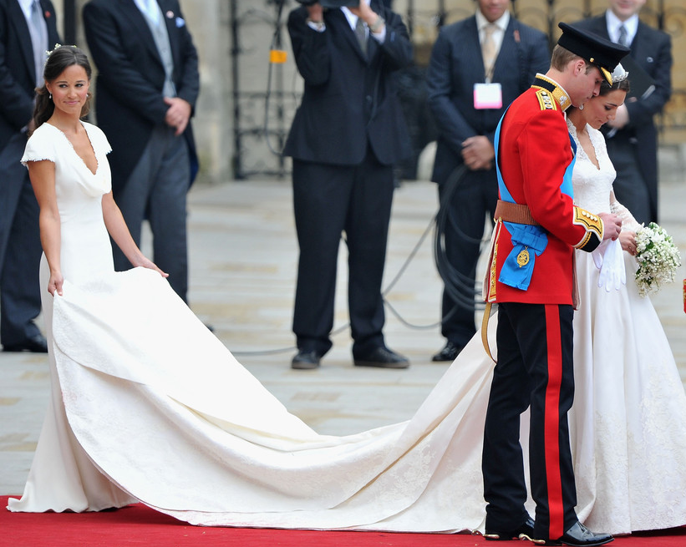
Big data, long tail
www.flickr.com/photos/infocux/8450190120
www.zimbio.com
A difference of degree
A difference of kind
Hard in an easy way
Hard in a hard way
Notes:
La tecnología de big data revolucionará la seguridad de la información, Infocux Technologies, http://www.flickr.com/photos/infocux/8450190120
Pippa Middleton royal wedding, Getty Images, http://www.zimbio.com/

Slide 5
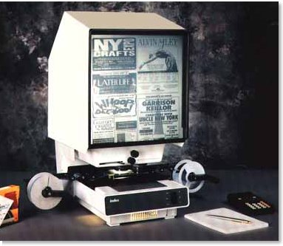
Meaningful engagement
www.worldmicrographics.com
Obsolescence through changing expectations
Static
Passive
Isolational
Static
Passive
Isolational
Dynamic
Immersive
Relational
Notes:
Roll film microfilm readers, World Micrographics, http://www.worldmicrographics.com

Slide 6
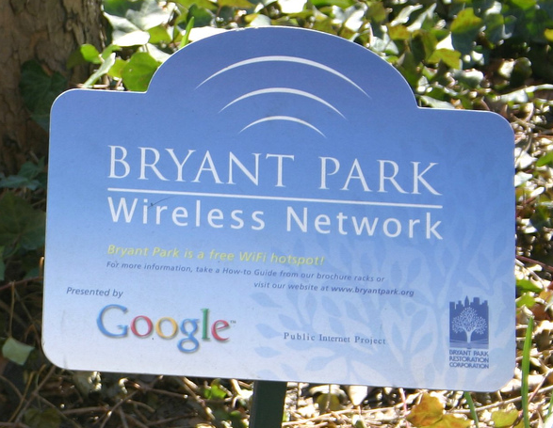
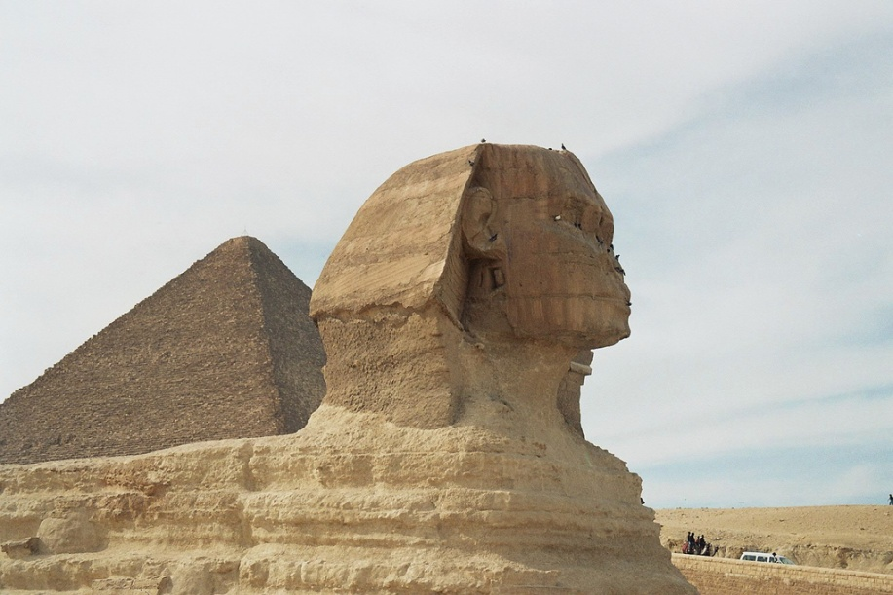
“We’ll have conquered all time, all space …”
— Jacques Brel
www.flickr.com/photos/46793639@N00/116823014
www.flickr.com/photos/8473570@N02/1999611456
Ubiquitous connectivity
Corrosive impact of time
Proliferation of devices
Who pays?
Notes:
Google Wifi Hotspot, Andrew West, http://www.flickr.com/photos/46793639@N00/116823014
Sphynx, François Philipp, http://www.flickr.com/photos/8473570@N02/1999611456

Slide 7
Save means …
Preservo-magic
File
Edit
View
Tools
Help
New
Open …
Print
Print preview
Save
Save as …
Exit

Slide 8
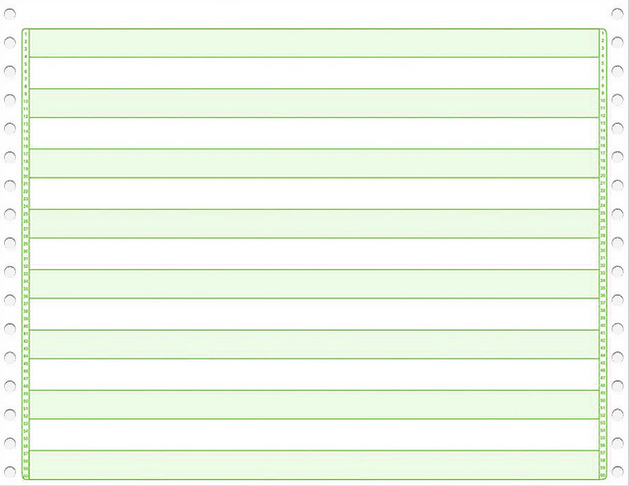
Save used to mean …
//myjob job slabrams,class=s
//analyze exec pgm=snap442,region=8k,
// time=(,30)
//outfile dd dcb=(blksize=8192,
// lrecl=80,recfm=fb),
// disp=(new,keep,keep),
// dsn=results,
// label=(1,,out),
// space=(8192,1024),
// unit=(3330-1,1),
// volume=(private,retain,,, // ser=a00280).
//
Notes:
“Green Bar” computer paper, David Swart, http://www.flickr.com/photos/dmswart/6507071701

Slide 9
Save should mean SAVE
Preservo-magic
Preservo-magic
File
File
Edit
Edit
View
View
Tools
Tools
Help
Help
New
Open …
Print
Print preview
Save
Save as …
Exit
New
Open …
Print
Print preview
Save
Save as …
Save, really
Exit
View
Tools
Help

Slide 10
www.keepcalmandposters.com
Stephen.Abrams@ucop.edu
www.cdlib.org/uc3

