Slide 1
There’s a bot in my library!
Danielle Kane
SCIUG 2013 Conference Wednesday, October 23 at Cal Poly Pomona

Slide 2
Overview
Program-O
Web-based chatbot
Staff: 1 librarian, 1 programmer, 1 library assistant
Focus Group: 13 library staff who provide feedback
Explored possibility of working with University of Nebraska-Lincoln

Slide 4
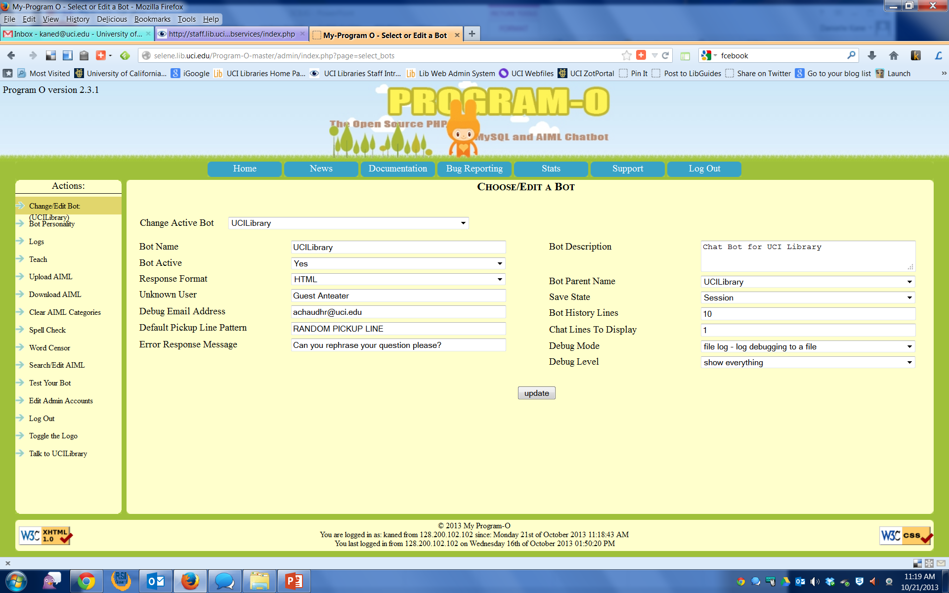
Development Phase

Slide 5
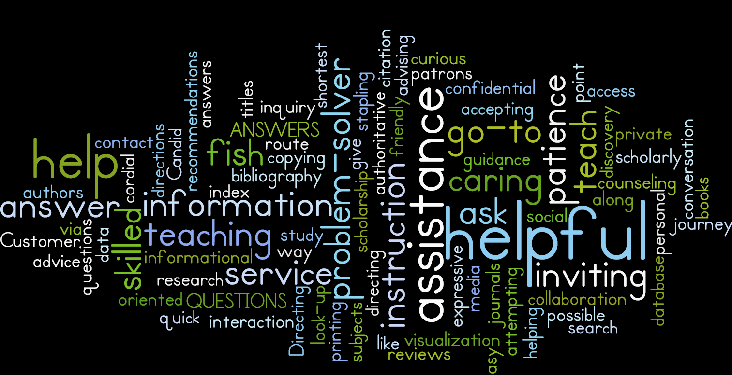
Team Phase

Slide 6
Prototype Phase
67 General .aiml files
Download from Program-O community
Biography, history, literature astrology, etc.
Original programing
Library related information
Locations, printing, library cards, course reserves, etc.
Subject Analysis
Project to identify resources to be recommended based on keywords

Slide 7
Creating Buzz
http://goo.gl/VzkteG

Slide 8
General Files
Responses about women:
<category><pattern>WHO IS MRS WASHINGTON</pattern><template>Martha Washington, wife of George.</template></category>
<category><pattern>WHO IS MARIE CURIE</pattern><template><formal> <set name="he"> <set name="topic"> Marie Curie. </set> </set> </formal>Discovered radium.</template></category>
Slightly judgmental:
<category><pattern>WHO IS GERHARD SCHROEDER</pattern><template><formal><set name="he">Schroeder</set></formal>was the Chancellor of Germany from 1998-2005. Christian Drossman said he is a complete idiot.</template></category>
<category><pattern>WHO IS GARTH BROOKS</pattern><template>A boring country singer with delusions of grandeur.</template></category>

Slide 9
Categories
<category><pattern>WHO CAN USE E-RESERVES</pattern>
<template>Current UCI students (including Extension), faculty, and staff.</template></category>

Slide 10
Symbolic Reduction
Scanners
Q: Scanners
* Scanners
Q: I’m looking for scanners.
Scanners *
Scanners, I need to find one.
* Scanners *
I need to find the scanners in the Langson Library.

Slide 11
Recursion
<category><pattern>SCANNER LOCATION</pattern>
<template>Scanners are available in Langson Library and Ayala Science Library. Check our <a href=" http://www.lib.uci.edu/services/printing.html?tab=2" target="_blank">printing page</a> for more information</template></category>
<category><pattern>* WHERE ARE THE SCANNERS *</pattern>
<template><srai>SCANNER LOCATION</srai></template></category>
<category><pattern>WHERE ARE THE SCANNERS *</pattern>
<template><srai>SCANNER LOCATION</srai></template></category>
<category><pattern>* WHERE ARE THE SCANNERS</pattern>
<template><srai>SCANNER LOCATION</srai></template></category>
<category><pattern>WHERE ARE THE SCANNERS</pattern>
<template><srai>SCANNER LOCATION</srai></template></category>

Slide 12
Research Help: Libguides

Slide 13
Research Help: Recommending Databases

Slide 14
Program Flow
<?xml version="1.0" encoding="ISO-8859-1"?>
<aiml version="1.0">
<category>
<pattern>I WANT MORE INFORMATION ON *</pattern>
<template><think><set name="topic">booksorarticles</set><set name="search"><star /></set></think>Did you want books or articles on <star />?</template>
</category>
<topic name="booksorarticles">
<category>
<pattern>BOOKS</pattern>
<template>Visit our ANTPAC site at to find more books on <get name="search" />. <antpac><get name="search" /></antpac>.</template>
</category>
<category>
<pattern>ARTICLES</pattern>
<template>Here is where you can find articles about <get name="search" />. </template>
</category>
<category>
<pattern>BOTH</pattern>
<template>Well, aren't you demanding!</template>
</category>
</topic>

Slide 15
Example
<category><pattern>GHOST PLAYS</pattern>
<template><think><set name=“it”>articles on<get name=“subject”/></set></think>We recommend you start your research with the following resources, <a href=" http://uclibs.org/PID/113654" target="_blank">Play Index</a> and/or <a href=“ http://infotrac.galegroup.com/itweb/univca20?db=LCO" target="_blank"> Drama Criticism.</a> For more resources take a look at the <a href=" http://libguides.lib.uci.edu/drama" target="_blank"> Drama LibGuide.</a> If you need more help please contact <a href=" http://www.lib.uci.edu/services/ask/ask-a-librarian.html" target="_blank"> Ask a Librarian.</a></template></category>

Slide 16
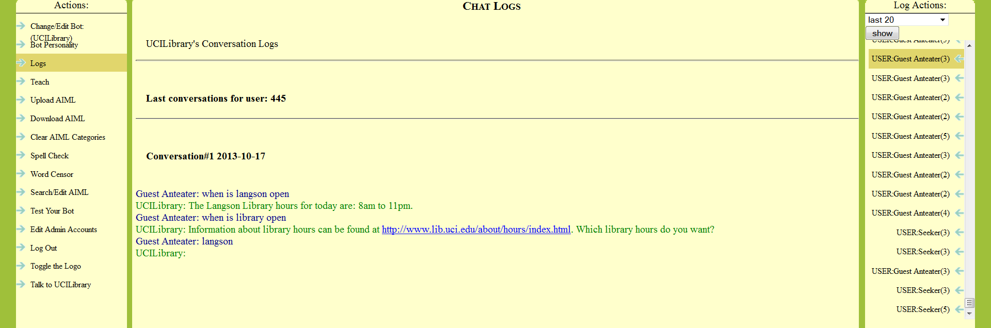
Testing: Phase 1 and 2

Slide 17
Thanks !
Danielle Kane
Research Librarian for Emerging Technologies and Service Innovation
Interim Education Librarian
Email: kaned@uci.edu
http://goo.gl/5xQwD

