Slide 1


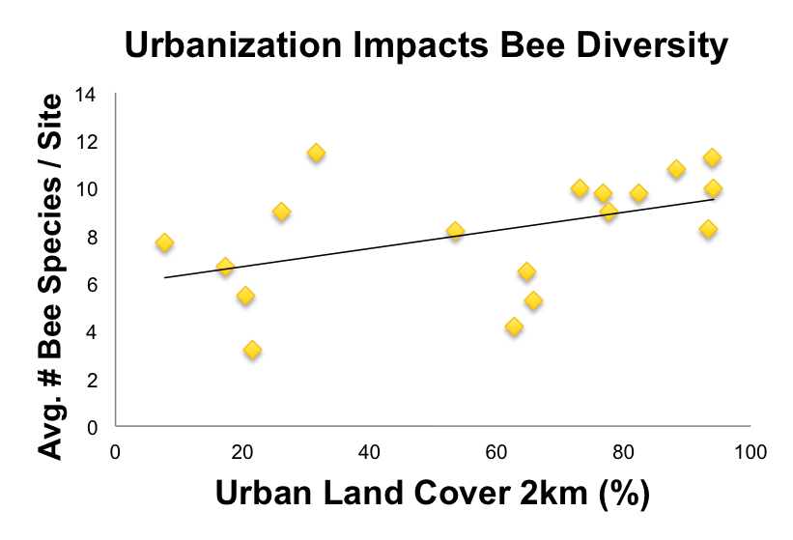
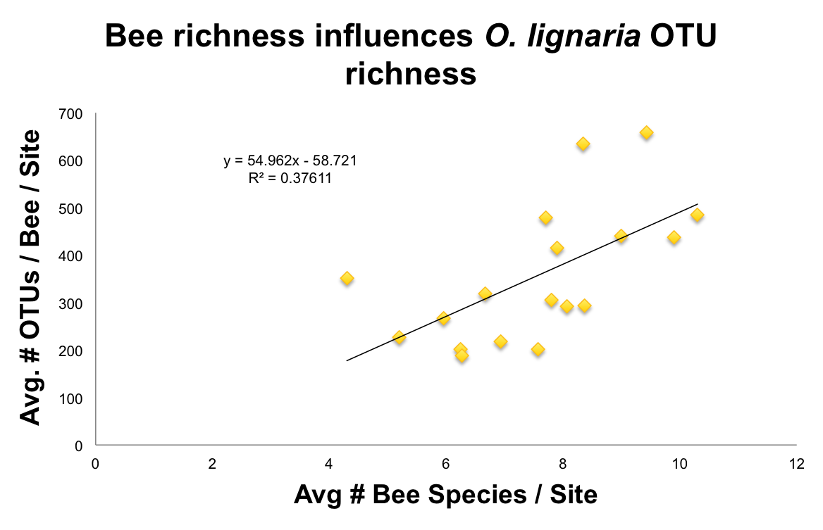
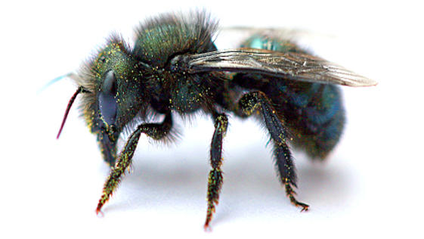
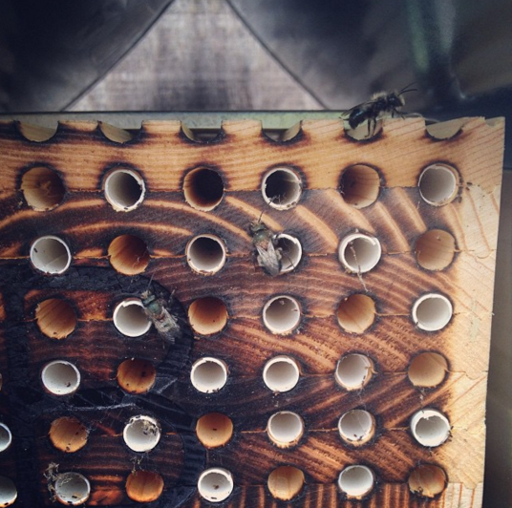
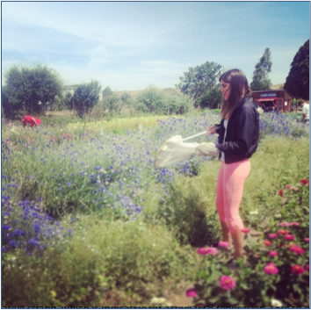
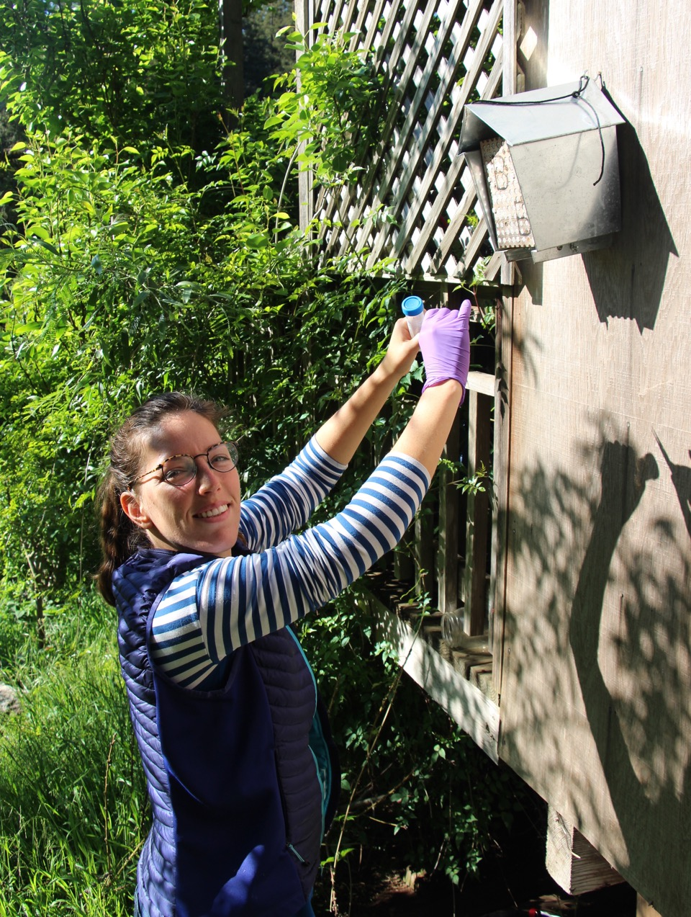
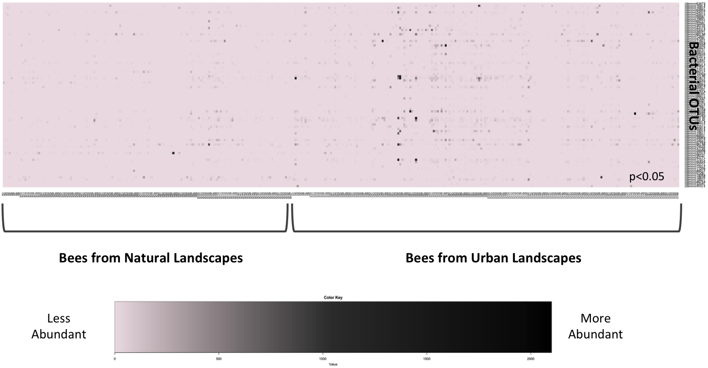
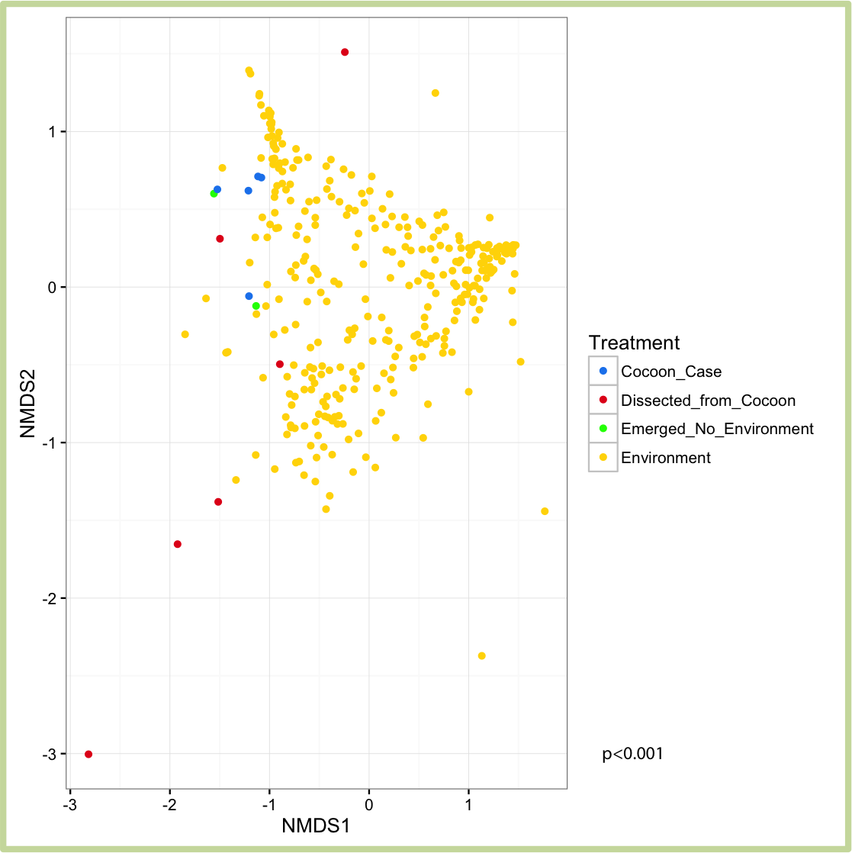
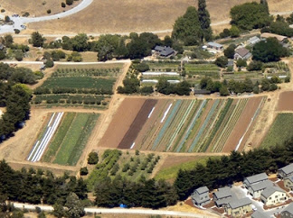
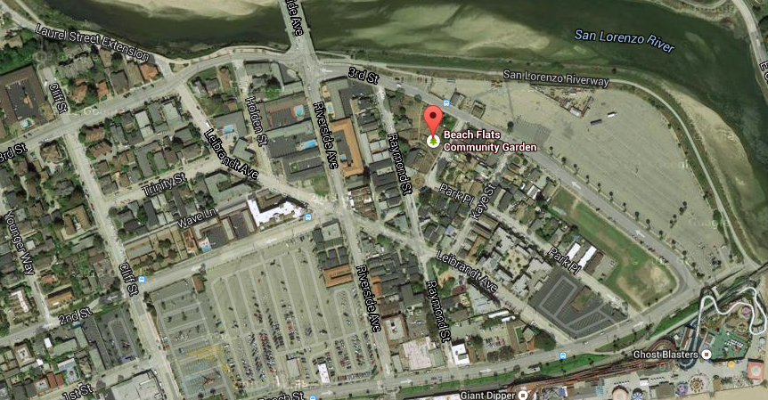
Urban landscapes impact the microbiome of the bee, Osmia lignaria
Hamutahl Cohen. Environmental Studies, UC Santa Cruz
Quinn McFrederick. Entomology. UC Riverside
Stacy Philpott. Environmental Studies, UC Santa Cruz
Introduction
Methods
Results, cont’d
Resource provisioning at multiple scales impacts bee abundance, richness and evenness¹, but little is known about impacts to bee health
Bees putatively acquire microorganisms², both beneficial and pathogenic³, from pollen and nectar resources
Floral resource availability & changes in land-use may therefore influence the composition of the bee microbiome & disease acquisition
Field Work
- Installed Blue Orchard Bees (Osmia lignaria) at each site
- Control treatment with no environmental exposure
- Bee diversity survey: visual, aerial netting, pan traps
- Vegetative surveys: 1x1m random quadrants and 20x20m plot
Lab Work
- ArcGIS to measure landscape features
- Next Generation Sequencing: 16s Illumina⁴
- PCR test for prevalence of fungal parasites:
Ascosphaera (Chalkbrood), Aspergillus (Stonebrood), Nosema
Urbanization drives variation in bee richness (p=0.051) &
bee richness influences microbial richness (p<0.01)
36 OTUs are differentially abundant between bees from natural landscapes and bees from urban landscapes (p<0.05)
Research Questions
Does environmental context confer bacteria to bees?
Does resource provisioning at the local and landscape scale impact the composition of the bee microbiome?
Does variation in microbiome composition impact the prevalence of fungal parasites?
Results
  42,104 distinct OTUs across the bees from all the sites
  ~1,000 OTUs make up 95% of all bacterial abundance
Environmental context is important for microbiome composition in O. lignaria
Conclusions
Study Site: Urban Gardens
Landscape processes such as urbanization that affect bee richness may also impact bee microbial diversity
Difficult to tease apart the implications of higher microbial richness for bee health because bee-microbe interactions are complex: some microbes are pathogenic, there may be competition between microbes, and microbial diversity has not been experimentally addressed in bees.
Forthcoming: analysis of garden local features and fungal parasite prevalence
Model system to understand how local and landscape-level features determine bee health
Research conducted in 18 urban gardens characterized by 3 distinct surroundings: forest, agriculture, impervious urban land cover
Literature Cited
¹Winfree, R. et al. (2007). Ecology Letters. 10(11): 1105-1113
²McFrederick, Q.S. et al. (2012). Molecular Ecology. 21(7): 1754-1768
³Dillon, R.J. & Dillon, V.M. (2004). Annual Reviews in Entomology. 49(1): 71-92
⁴Hanshew A.S. et al. (2013). Journal of Microbiological Methods. 95.
  Bees allowed to naturally forage host a different bacterial community than bees that pupated in sterile control conditions (p<0.001)
The bees from urban landscapes have a larger range of average OTU richness. On average, the bees from urban landscapes had 200-800 OTUs. But bees from natural landscapes, on average, had around 200-450 OTUs.
The landscape context of the UCSC garden (left) is predominately surrounded by agriculture, whereas urbanization characterizes Beach Flats Community Garden (right) in Santa Cruz, CA.
Acknowledgements
Kaleigh Russell, Dr. Peter Graystock, Peter Bichier, Center for Agroecology & Sustainable Food Systems, and the gardens in this study: Forge, Berryessa, Prusch, Coyote Creek, La Colina, Laguna Seca, Mearth, MIIS, Seaside, Chinatown, Salinas, Mesa Verde, Aptos, The Grange, Beach Flats, Homeless Garden Project, CASFS Farm, Chadwick Garden

