Slide 1
Utilizing Screen Sharing Tools to Connect
Internet Librarian 2013
Oct. 28-30, 2013
Monterey, CA
B303 - Retooling Tech: Screensharing & Virtualized Workspaces
Danielle Kane & Jeff Schneidewind
University of California, Irvine

Slide 2
Name | Cost | Talk | Chat | Webcam | Share screen | Mobile | Down-load | Participants
AnyMeeting | Free w/ads $18 per account / no ads | √ | √ | √ | √ | Attend | Java | Free: 200 (ads) paid = 25/200
Google+ | Free | √ | √ | √ | √ | √ | Plug-in | Up to 10
Join.me | $13-$19/month per presenter. | √ | √ | No | √ 1 window | √ | Plug-in | Up to 10
Uberconference | Pro version for $10 / $20 per month for toll-free calling | √ | No | No | No | √ | No | 5
Screenleap | Free | No | No | No | √ | √ | Java | 50-100 viewers.
Quick Screenshare | Free | No | No | No | √ | No | Java | 1 to 1
WebX | Free License: $24, $49, $89 | √ | √ | √ | √ | √ | No | Varies by License
Screen Stream | Free | Optional | √ | √ | √ | √ | √ | Limited by bandwidth
Show Screen | $40/month | No | No | No | √ | No | Java | Up to 15
Chart prepared by Kane, D. & Buckley, A. 2013

Slide 3
Google+ Hangouts & Join.me
https://join.me/
http://www.google.com/+/learnmore/hangouts/

Slide 4
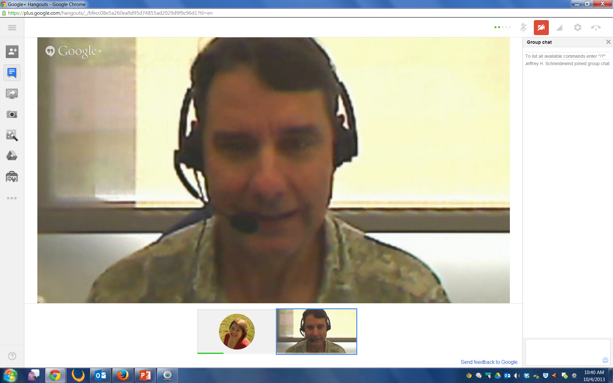

Slide 5
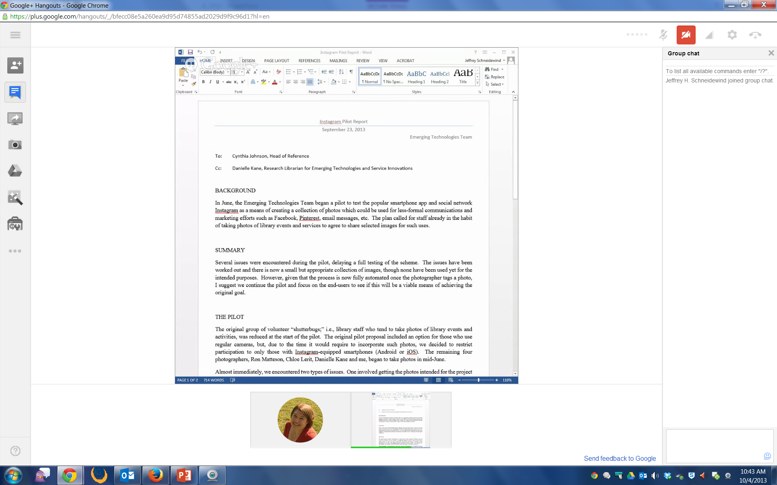

Slide 7
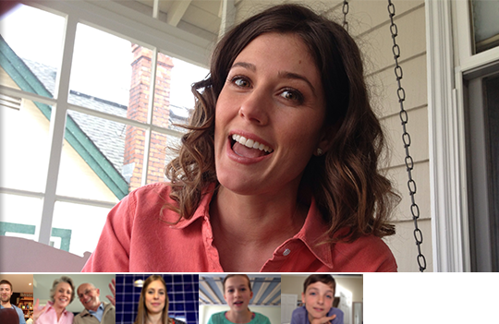
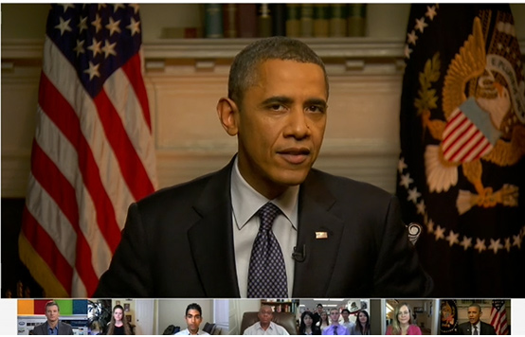
Many Ways to Screenshare
Collaboration
Meetings/Conference “Calls”
Ad Hoc consultations
Instruction

Slide 9
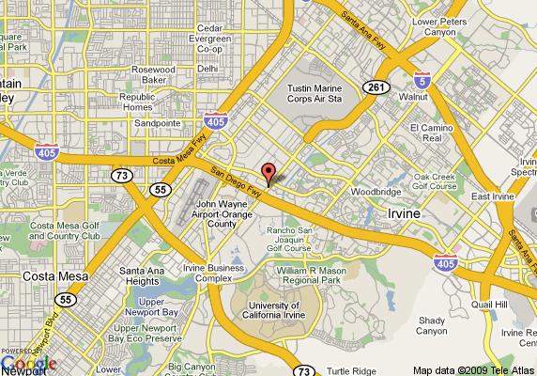
The UCI Library Experience
Project Management
Evaluate
Design
Develop
Assess

Slide 10
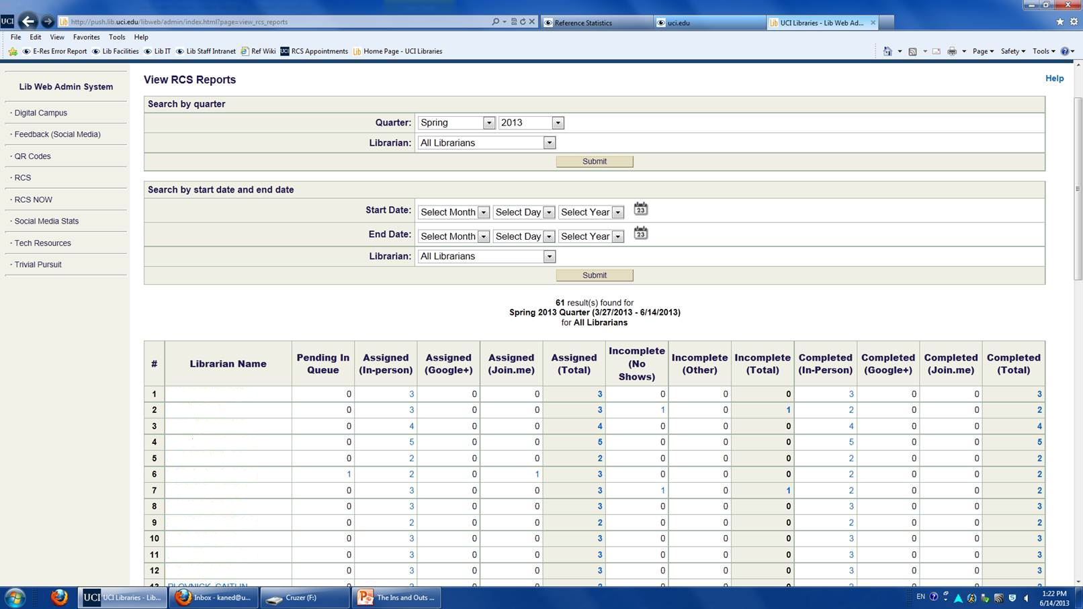

Slide 11
Questions
Danielle Kane
kaned@uci.edu
Jeff Schneidewind
jhschnei@uci.edu
http://lib.uci.edu/jhs
http://goo.gl/5xQwD

