Slide 1
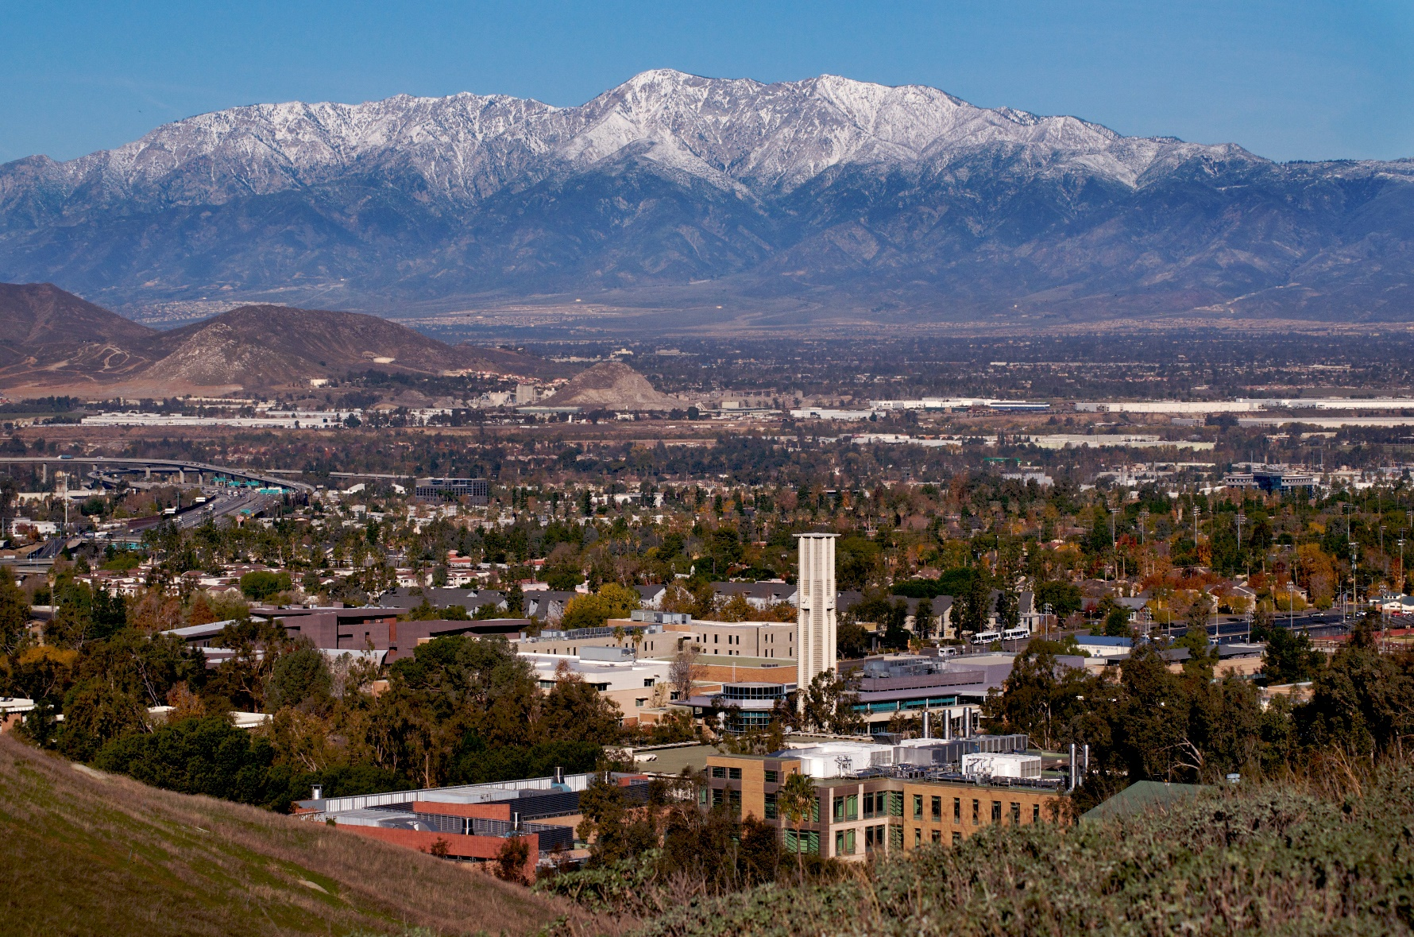
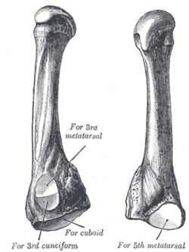
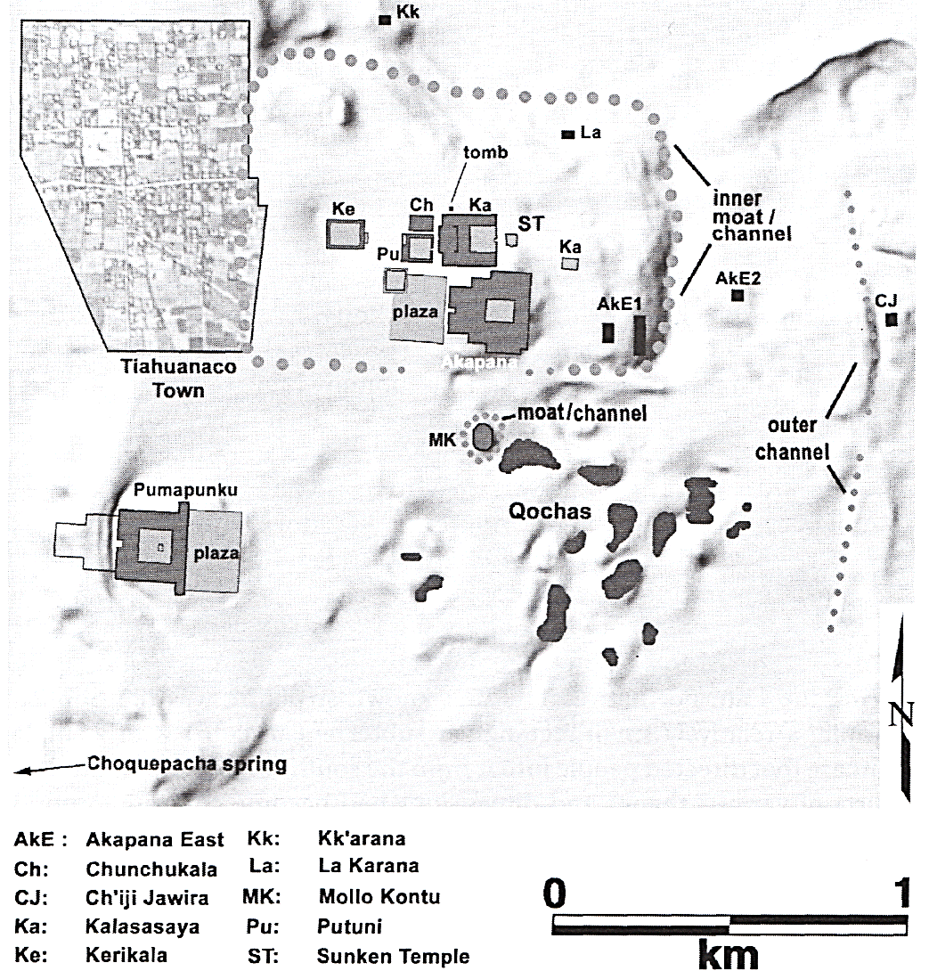
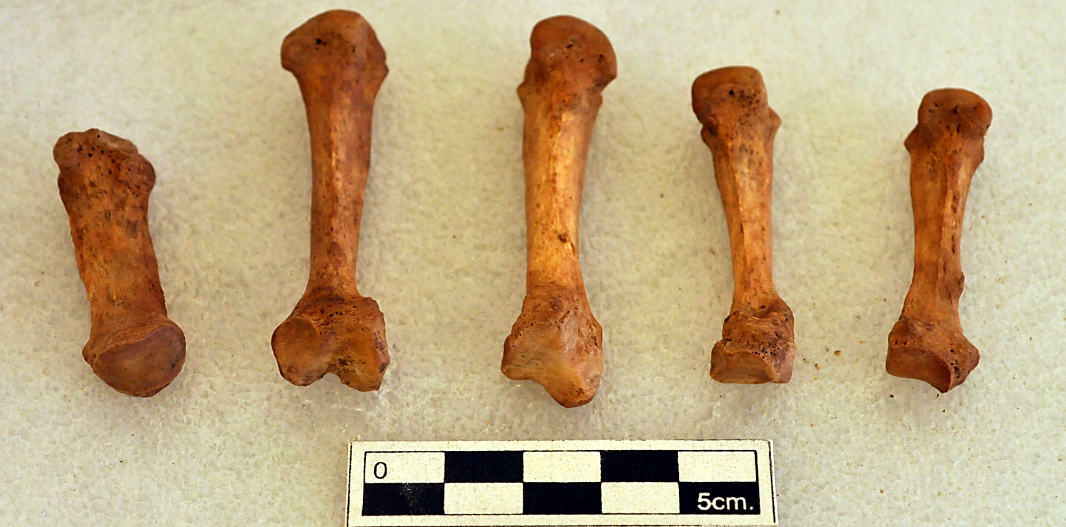
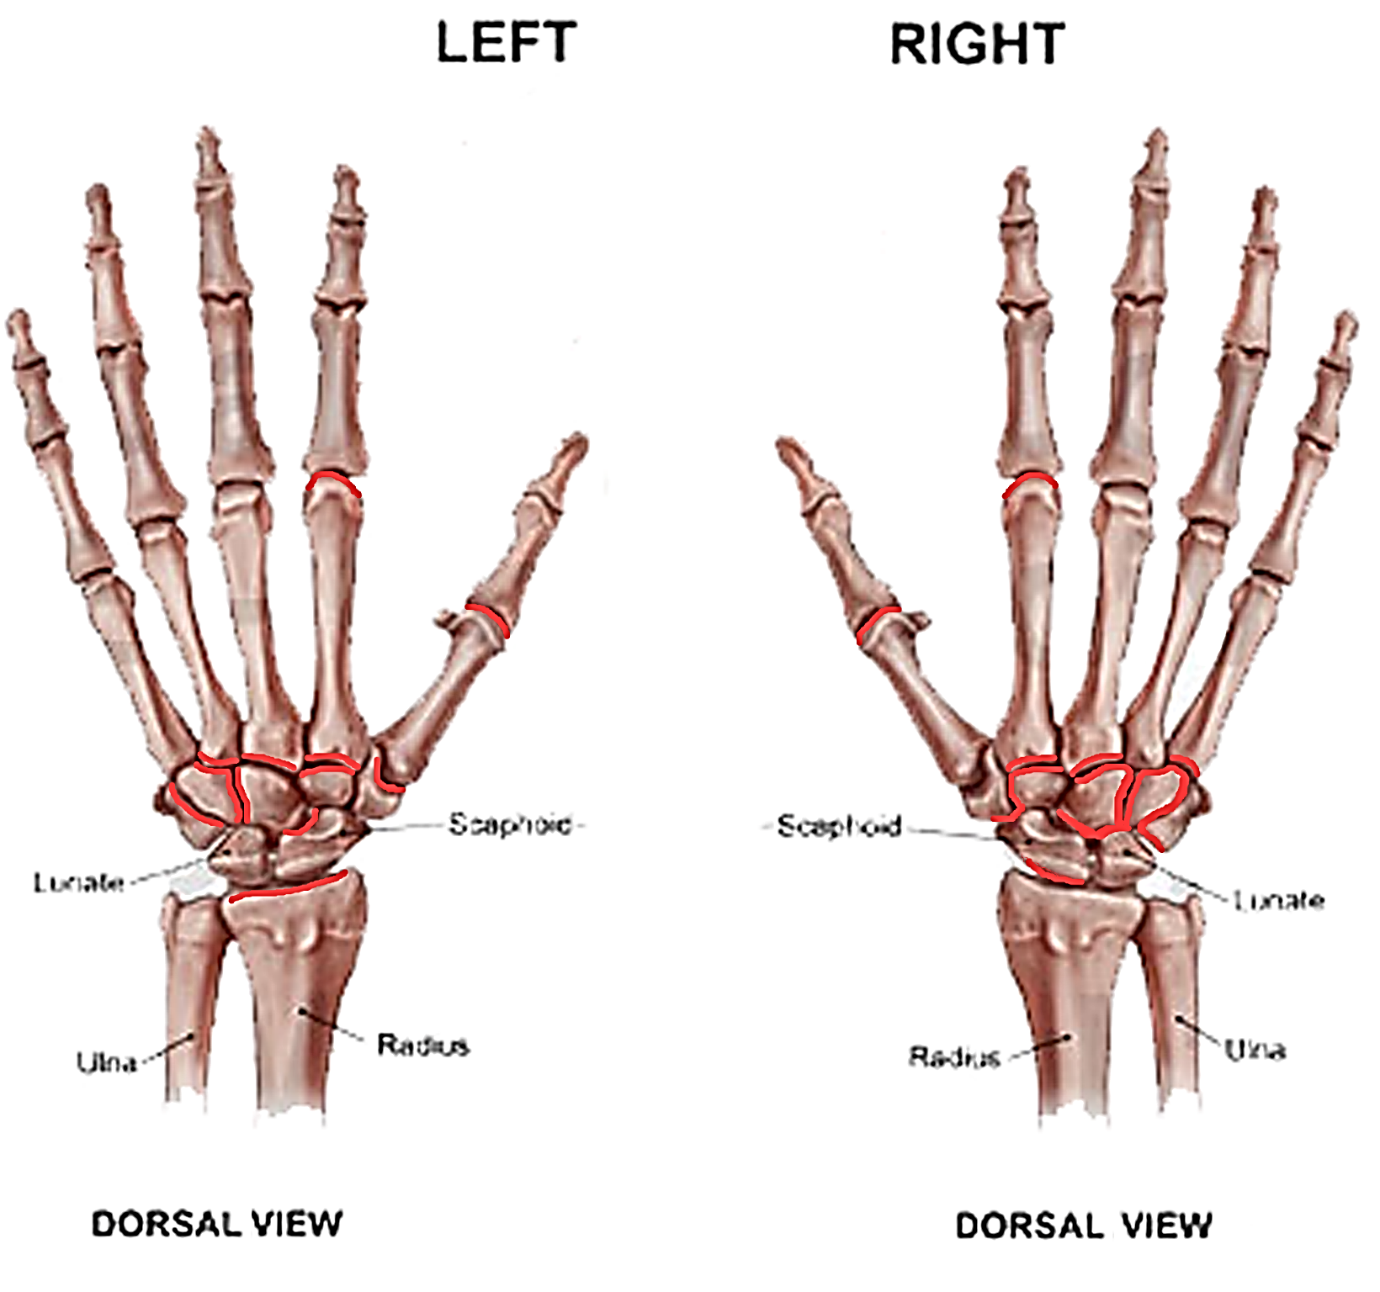
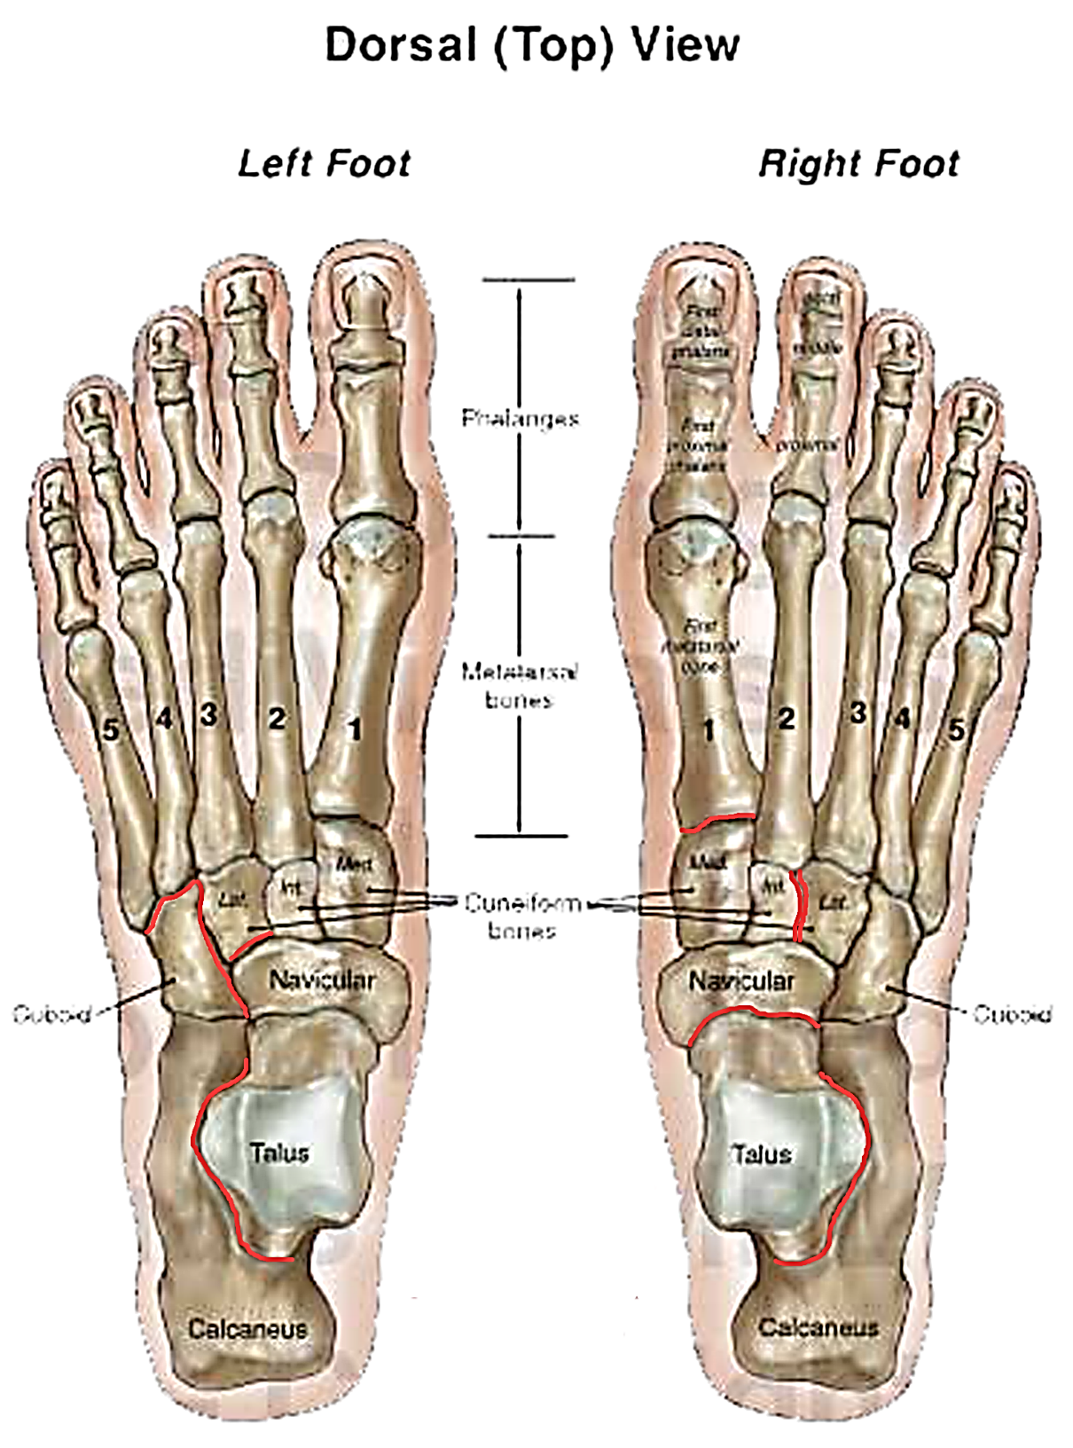
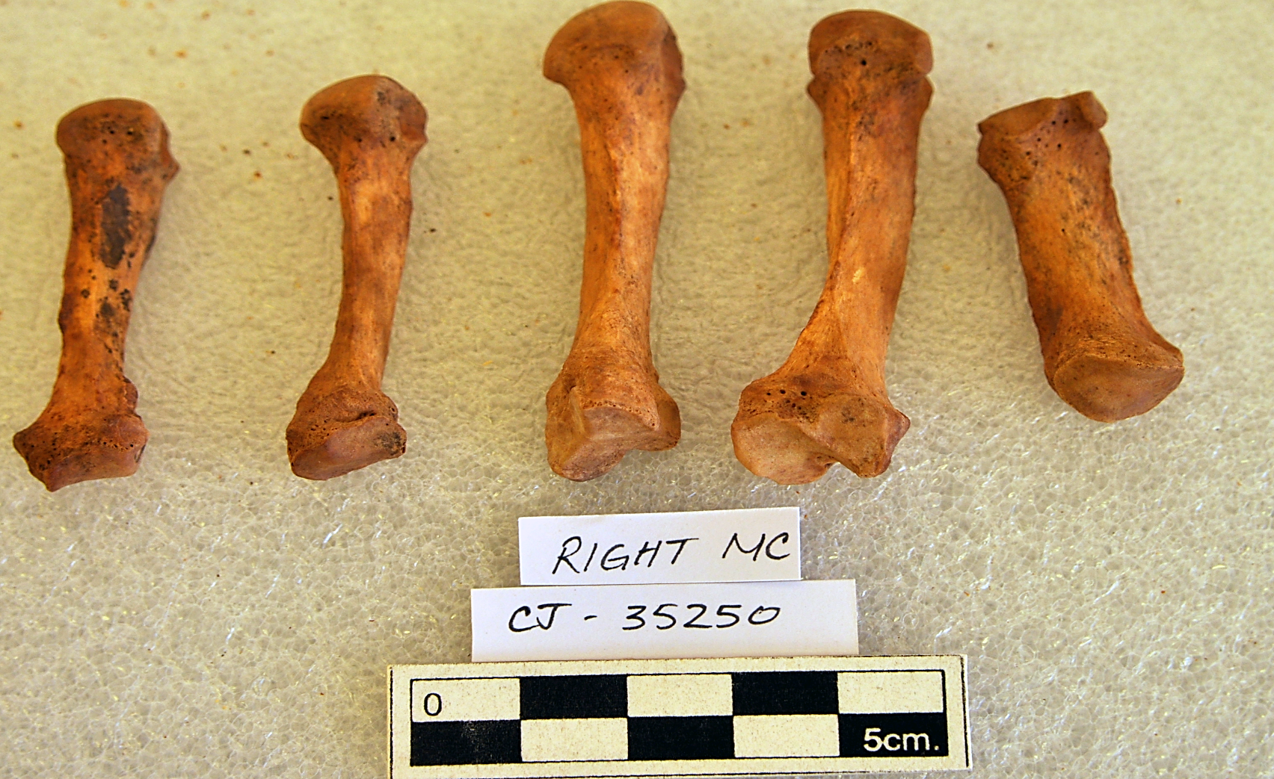
Did Potters Urn?
Potential Skeletal Evidence of Ceramic Production
from the Ch’iji Jawira Site in Tiwanaku, Bolivia
Sara K. Becker Department of Anthropology, University of California-Riverside
Introduction & Background
The Tiwanaku culture (AD 500-1100) was one of the earliest state-level societies in the south-central Andes (Janusek 2004; Kolata 1993; Stanish 2013) (Figure 1). The city of Tiwanaku was a dense, multiethnic urban center with some neighborhoods home to guild-like specialists laboring at differing jobs (Albarracín-Jordán 1996; Becker 2013; Janusek 2008). Ch’iji Jawira (CJ) is described as a residential area home to ceramic manufacturers and is located east of the center of the city (Figure 2). Settlement at this site began during the Late Formative (AD 300-500), emerging as a dual residential compound and ceramic production area in Tiwanaku times (AD 500-1100). CJ was close to a clay source/procurement area and a semi-permanent water supply (Rivera 2003:306). Janusek (2004:147) argued that CJ people were craft specialists, akin to a Western craft guild, and ceramics produced at this site were likely for the Tiwanaku public.
My prior bioarchaeological research (Becker 2013) shows people from CJ have significant skeletal differences from other Tiwanaku city residents in potential indicators of activity (e.g. musculoskeletal stress markers and osteoarthritis). This study further explores the idea that CJ was home to ceramic specialists using a life-history approach, describing one individual from this community, a 30-39 year-old female (CJ-35250) with artificial cranial modification from a flexed, individual burial context. Excavation records show grave goods including: (1) an undecorated and roughly finished vasija (urn), (2) a gold miniature mask, and (3) a camelid offering. While there are no radiocarbon dates, it is possible this burial is part of the earliest evidence of occupation at CJ. The vasija style, paste, and finish are akin to the Late Formative 2/Qeya style, which may date to AD 300-500.
Materials and Methods
Age and sex were estimated for CJ-35250 using standard methods (Bass 1981; Ubelaker 1999). Macroscopic investigation was collected for musculoskeletal stress markers (MSM) and osteoarthritis (OA). MSM can help identify directional movement in the kinds of activities performed as well as levels of physical labor, such as workload. OA can show injuries that are helpful in estimating repetitive labors and motion used over and over again, such as grinding grain. MSM data were recorded as present/absent for 37 different musculoskeletal stress markers, taking an ordinal score of 1 to 3 for robusticity, stress, and ossification when present following methods by Hawkey and Merbs (1995). Over 100 joint surfaces were evaluated for OA in various areas of the body (i.e. shoulder, elbow, wrist, sacroiliac, hip, knee, ankle, spine, hands, feet, and temporomandibular joints). Each surface was noted as present/absent for OA, and if present, type of OA (i.e. lipping, porosity, osteophytes, and eburnation), an ordinal score, and percentage of involvement were noted.
Activity & Labor Results
MSM Results:
Present in the left and right arms, legs, and hips
More and stronger (ordinal scale markers) on the left side
Forearm musculature had high presence/numbers in brachialis, biceps brachii, supinator, pronator quadratus, and brachioradialis muscles
Often active in precision tasks!
Lower body had high numbers in gluteus maximus and piriformes
Often active in movements like walking or running!
Rugosity in hands at finger phalanges (Figure 3)
Hand rugosity at interosseous muscle attachment points on the metacarpals (Figure 4)
Rugosity in foot metatarsals (MT) (Figure 5) and a close-up example of the right MT4 (Figure 6)
OA Results:
Temporomandibular joint: left evidence of lipping at cranium, right side had flattening on the mandibular condyle
Arms and legs: minor levels of OA with non-bilateral lipping in the left and right elbows and left wrist
Mid-body: medium to high levels of OA (lipping, porosity, and osteophyte formation) in both left and right sacroiliac joints and right hip
Spine: lipping and osteophyte formation in the lumbar vertebrae
Hands and Feet: multiple surfaces within these bones
Pattern of involvement noted in hands (Figure 7) and feet (Figure 8)
Discussion & Conclusions
There is no one definitive pattern of skeletal evidence pointing to CJ-35250’s occupation. The evidence of MSM and OA in the hands and feet, especially for her age, along with the higher levels of MSM in the forearm musculature could indicate precision tasks like crafting (Becker 2013). Modern studies (Arnold and Espejo 2015; Druc 2016) of Andean potters and weavers show that both hands and feet can be used in the process of manufacturing cloth and designs in cloth (Figure 9), as well as in shaping ceramics (Figure 10).
The OA and MSM evidence could be part of repeated plantar-facing motions. Strong MSM in hand musculature and evidence of OA in the wrist and fingers of CJ-35250 further support heavy, repetitive work in forearms, wrists, hands, and fingers. As CJ-35250’s burial lacks the ceramic molds and patterns of broken sherds noted in temporally later CJ burials (ca. 800-1000) (Rivera 2003), it is also possible that she was a weaver. However, any textiles buried with her have long since decayed. It is also conceivable she was a metalworker from the gold mask present in her burial and skeletal evidence of crafting. Future research will explore if there is a hand-foot pattern noted in metal work and/or patterns of bone involvement in other areas with better preservation of Tiwanaku textiles (e.g. Moquegua, Peru).
Acknowledgements: The Bolivian Ministry of Culture, the town of Tiwanaku, Deborah Blom, Kelly Knudson, John Janusek, Corey Bowen, UCR, and grant funding provided by the National Science Foundation.
a
Figure 6. Fourth metatarsal of right foot with some evidence of MSM bony growths from (6a) medial view and (6b) lateral view noted by arrows and (6c) for comparative purposes of an MT4 that lacks major rugosity
b
c
Figure 3. Finger phalanges with some MSM bony growths noted by arrows
Figure 1. Map of the study region,
with star at the city of Tiwanaku.
Figure 2. Neighborhoods within
the city of Tiwanaku. Dot notes the
location of Ch’iji Jawira (CJ) (after Janusek 2008:109)
a
Figure 7. Pattern of OA in the hands of CJ-35250 as noted in red
Figure 8. Pattern of OA in the dorsal view of feet for CJ-35250 as noted in red
b
Figure 4. Metacarpals of the left (4a) and right (4b) hand with some evidence of bony MSM growths noted with arrows
Figure 9. Weaving using feet (from Arnold and Espejo 2015:127)
Figure 10. Potting using feet (from Druc 2016:31)
a
Works Cited:
b
Albarracín-Jordán J. 1996. Tiwanaku settlement system: the integration of nested hierarchies in the lower Tiwanaku Valley. Latin American Antiquity 7(3):183-210. Arnold DY, and Espejo E. 2015. The Andean Science of Weaving: Structures and Techniques for Warp-Faced Weaves. New York: Thames & Hudson. Bass W. 1981. Human osteology: a laboratory and field manual of the human skeleton. Columbia, MO: Missouri Archaeological Society. Becker SK. 2013. Labor and the Rise of the Tiwanaku State (AD 500-1100): A Bioarchaeological Study of Activity Patterns. Chapel Hill, NC: University of North Carolina, Chapel Hill. Druc IC. 2016. Traditional Potters: from the Andes to Vietnam: Deep University Press. Geisso M. 2011. Stone Tool Production in the Tiwanaku heartland: the Impact of State Emergence and Expansion on Local Households. Oxford: Archaeopress. Hawkey DE, and Merbs CF. 1995. Activity-induced musculoskeletal stress markers (MSM) and subsistence strategy changes among ancient Hudson Bay Eskimos. Int J Osteoarchaeol 14:7-17. | Janusek JW. 1999. Craft and local power: embedded specialization within Tiwanaku cities. Lat Am Antiq 10(2):107-131. Janusek JW. 2004. Identity and Power in the Ancient Andes: Tiwanaku cities through time. New York: Routledge. Janusek JW. 2008. Ancient Tiwanaku. New York: Cambridge University Press. Kolata AL. 1993. The Tiwanaku: portrait of an Andean civilization. Oxford: Blackwell. Rivera C. 1994. Chiji Jawira: Evidencias Sobre La Producción De Cerámica En Tiwanaku [Tesis de Licenciatura]. La Paz: Universidad Mayor de San Andrés. Rivera C. 2003. Ch'iji Jawira: A Case of Ceramic Specialization in the Tiwanaku Urban Periphery. In: Kolata A, editor. Tiwanaku and Its Hinterland: Archaeology and Paleoecology of an Andean Civilization, vol 2: urban and rural archaeology. Washington, DC: Smithsonian Institution Press. p 296-315. Stanish C. 2013. What Was Tiwanaku? . In: Vranich A, and Stanish C, editors. Visions of Tiwanaku. Los Angeles: Cotsen Institute of Archaeology Press. p 151-166. Ubelaker D. 1999. Human Skeletal Remains: Excavation, Analysis, Interpretation. Washington, D.C.: Taraxacum.
Figure 5. Metatarsals of the left (5a) and right (5b) foot with some evidence of MSM bony growths noted by arrows

