Slide 1
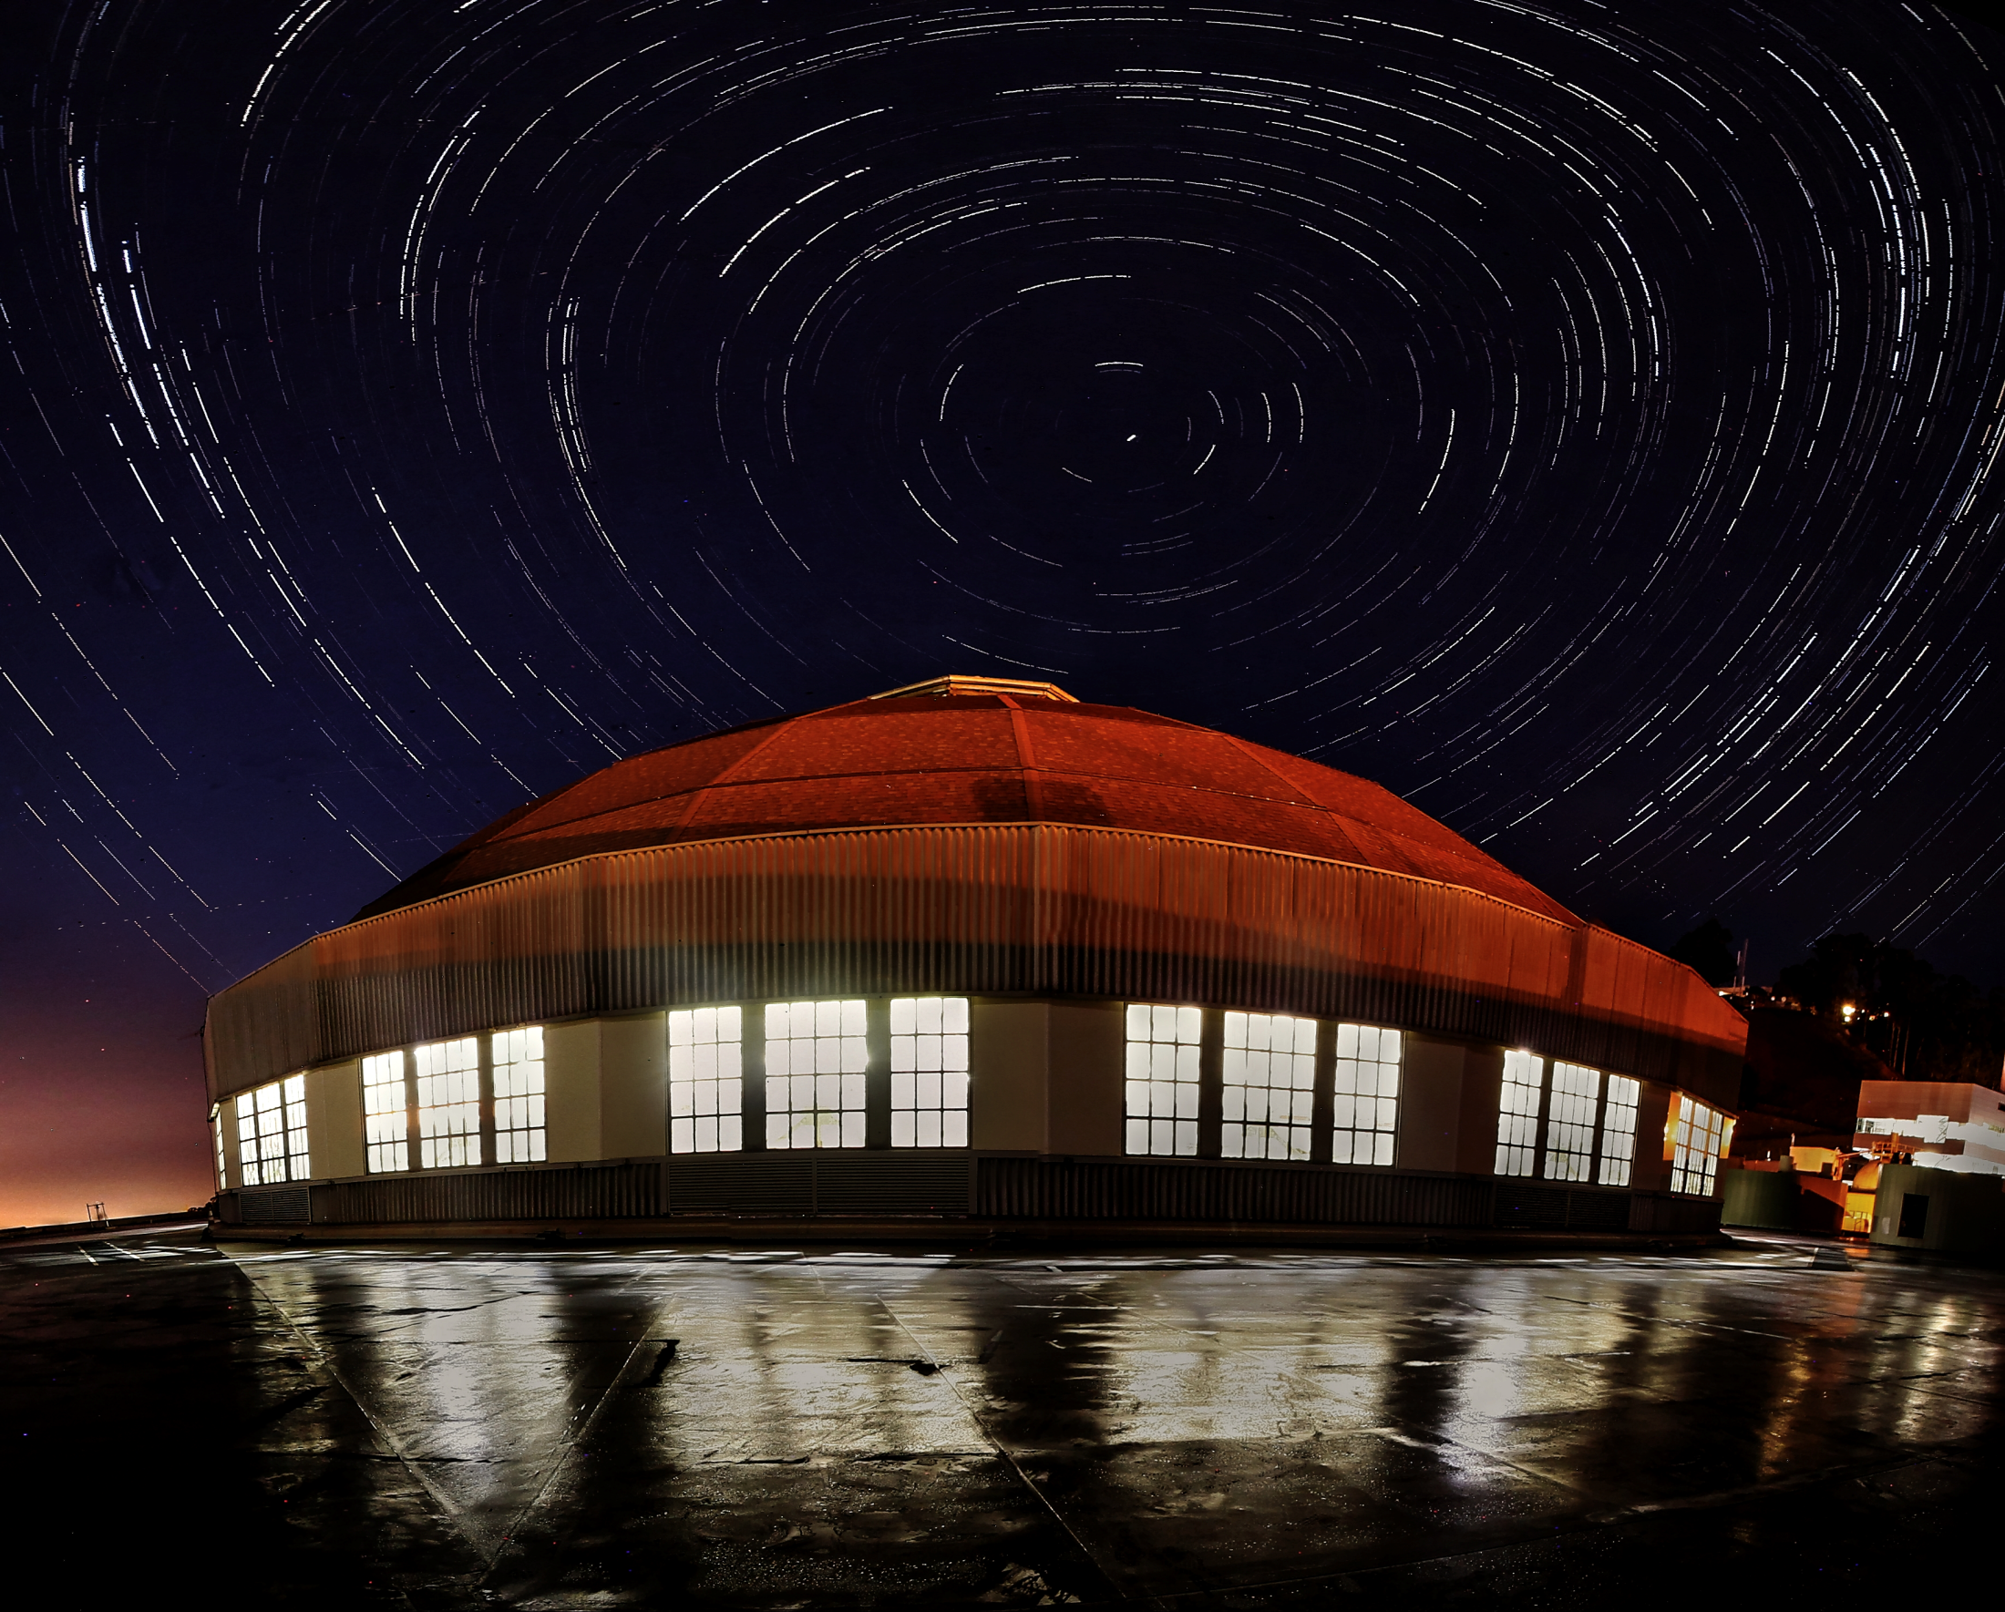
Presentation title
X-Ray Optics Laboratory at the ALS: current capabilities, new challenges, and tasks for further development
Presenter Name
Job Title, Affiliation
Date
Ian Lacey
Sr. Scientific Engineering Associate, ALS - ESG
7 August 2017
Jérôme Adam,^{1,2} Gary P. Centers,^{1,3} Gevork Gevorkyan,¹ Sergey Nikitin,¹ Brian V. Smith,¹ and Valeriy V. Yashchuk¹
¹Lawrence Berkeley National Laboratory, 1 Cyclotron Rd., Berkeley, California 94720
²École nationale supérieure d'ingénieurs de Caen & Centre de Recherche (ENSICAEN), 6 Boulevard Maréchal Juin, 14000 Caen, France
³Helmholtz Institute, JGU Mainz, Staudingerweg 18, 55128 Mainz, Germany

Slide 2
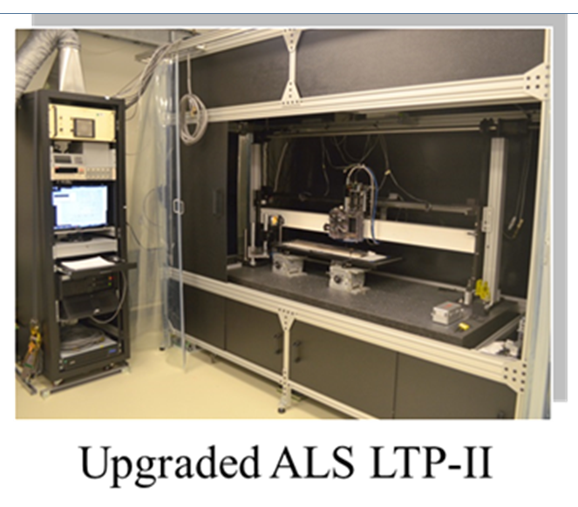
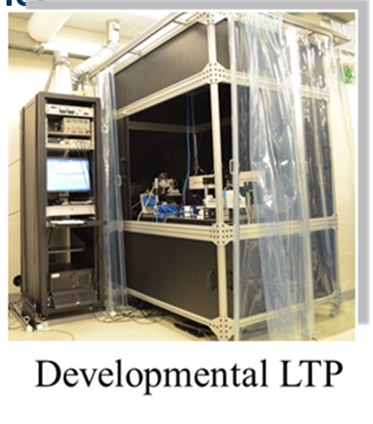
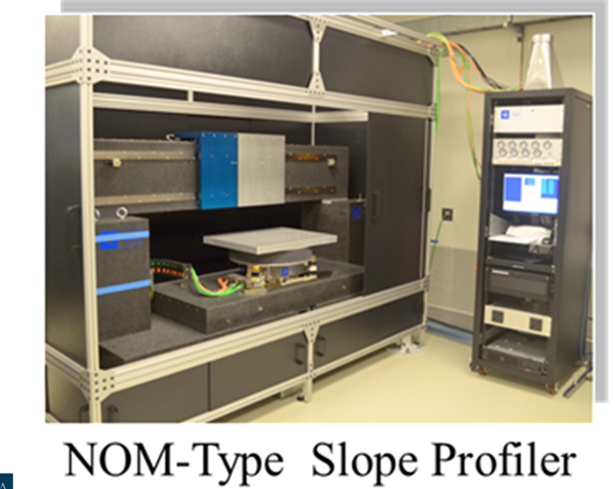
Slope Profilometers

Slide 3
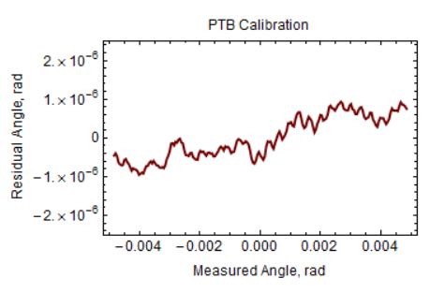
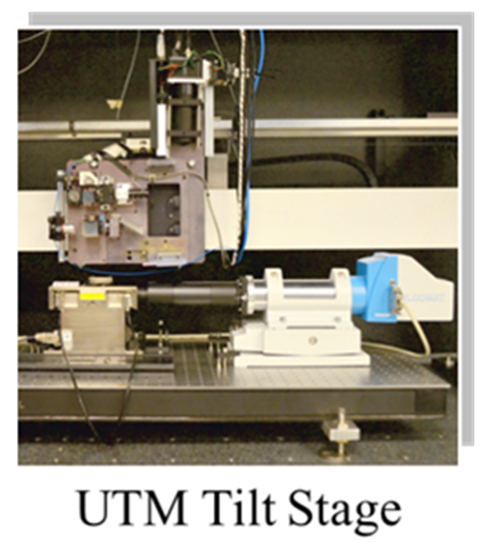
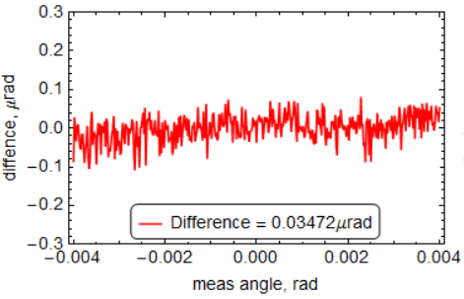
Calibration Tools

Slide 4
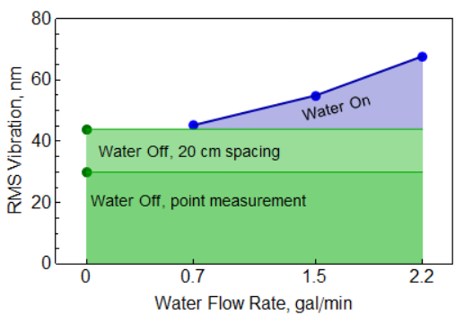
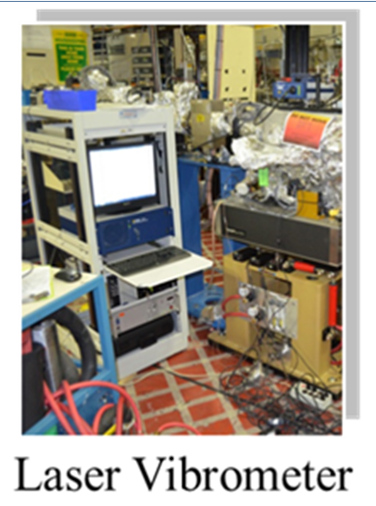
Calibration Tools

Slide 5
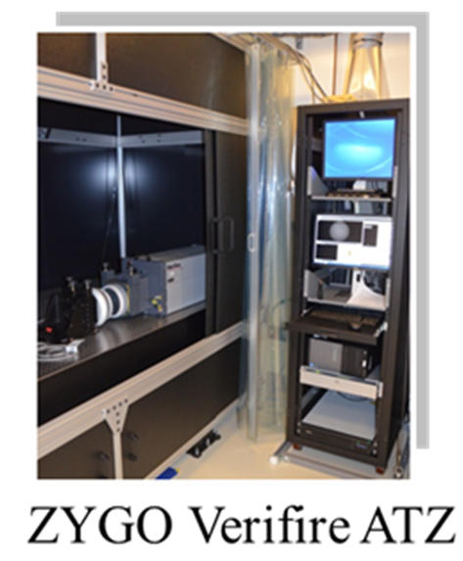
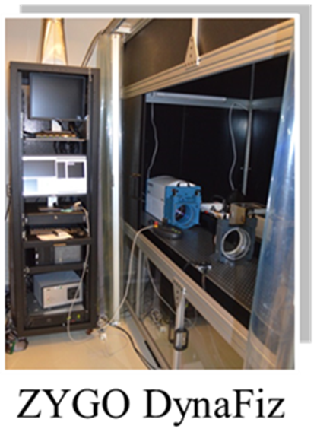
Interferometers

Slide 6
Interferometers

Slide 7
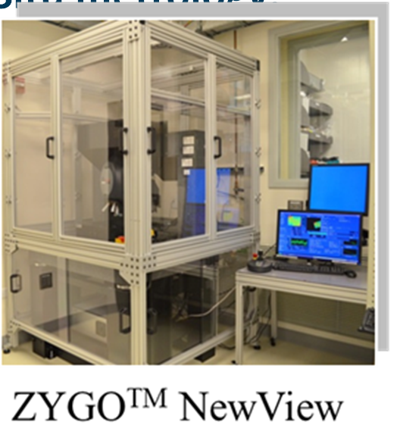
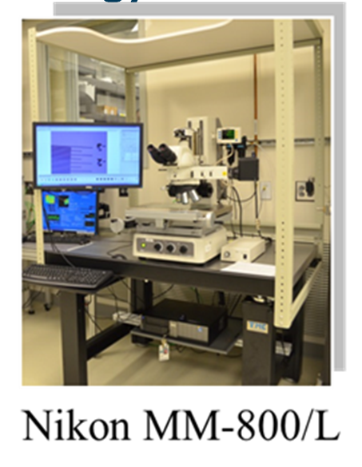
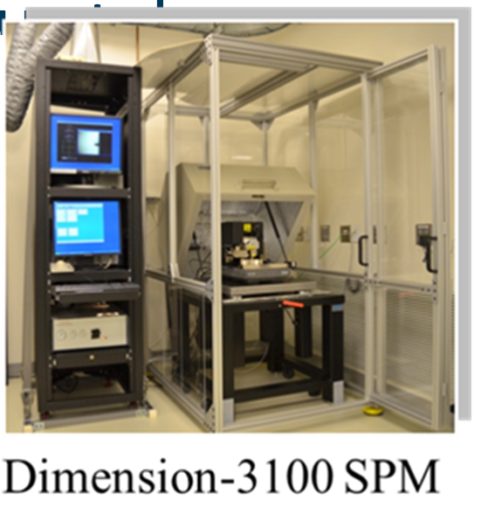
A few more to skip here:

Slide 8
Buried Lede: 1-D Slope Profilometry
Add a time delay between
repeat scans in opposite directions

Slide 9
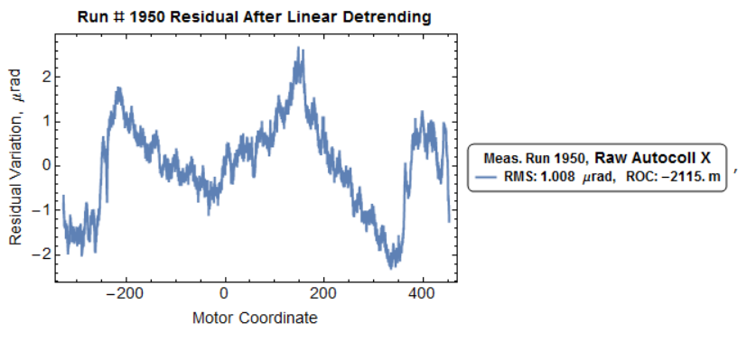
Add time delay between scans in opposite directions

Slide 10
Add time delay between scans in opposite directions
surface
systematic
error
drift
random
noise
periodic
perturbation

Slide 11
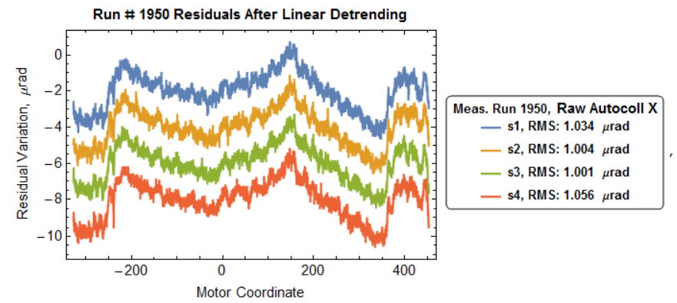
Add time delay between scans in opposite directions
surface
systematic
error
drift
random
noise
periodic
perturbation

Slide 12
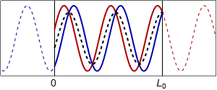
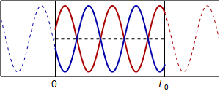
Add time delay between scans in opposite directions
Introduce delay between scans

Slide 13
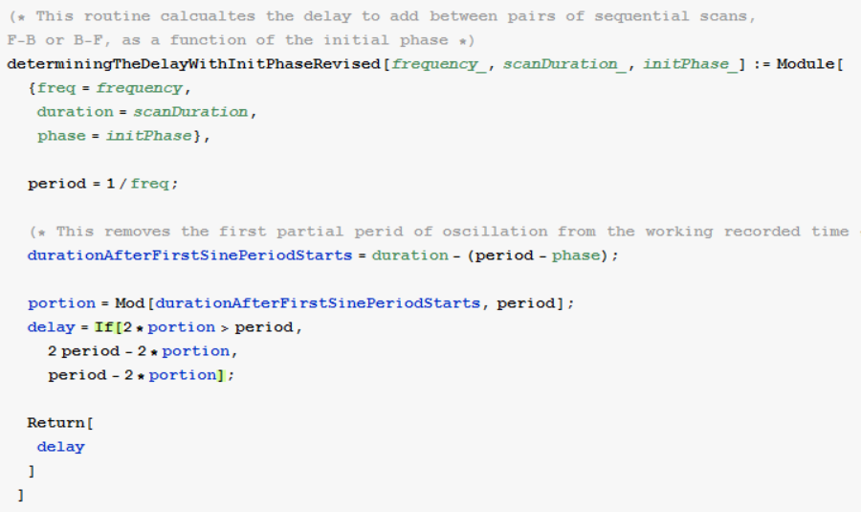
Add time delay between scans in opposite directions

Slide 14
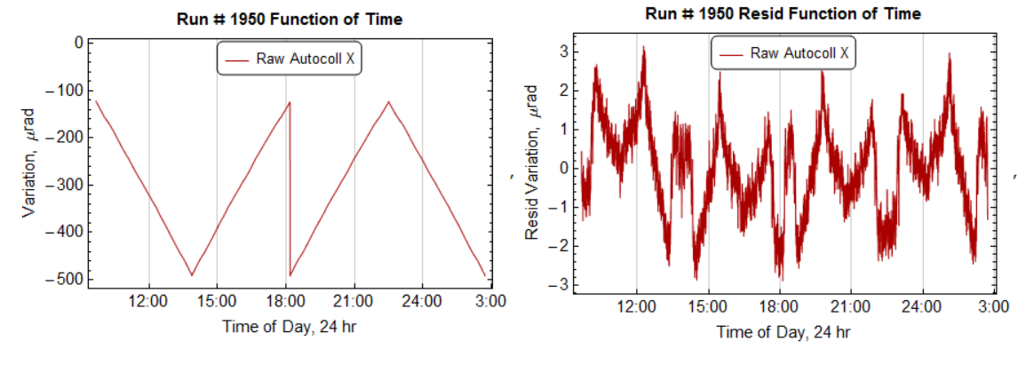
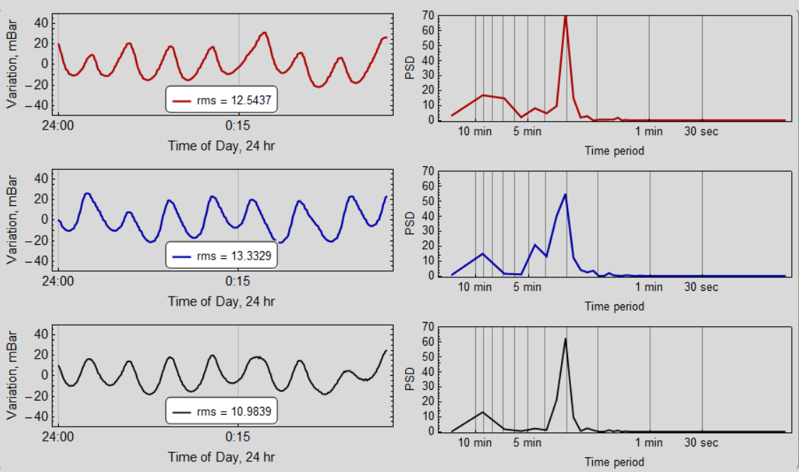
Add time delay between scans in opposite directions

Slide 15
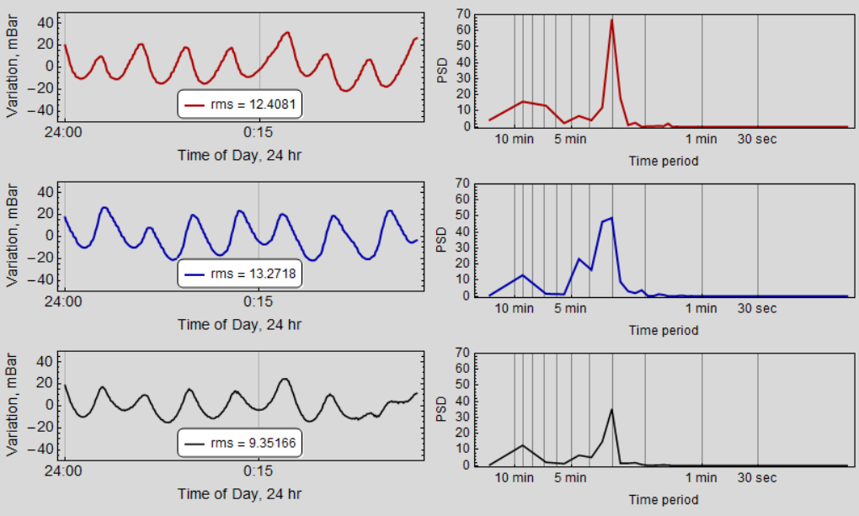
Add time delay between scans in opposite directions

Slide 16
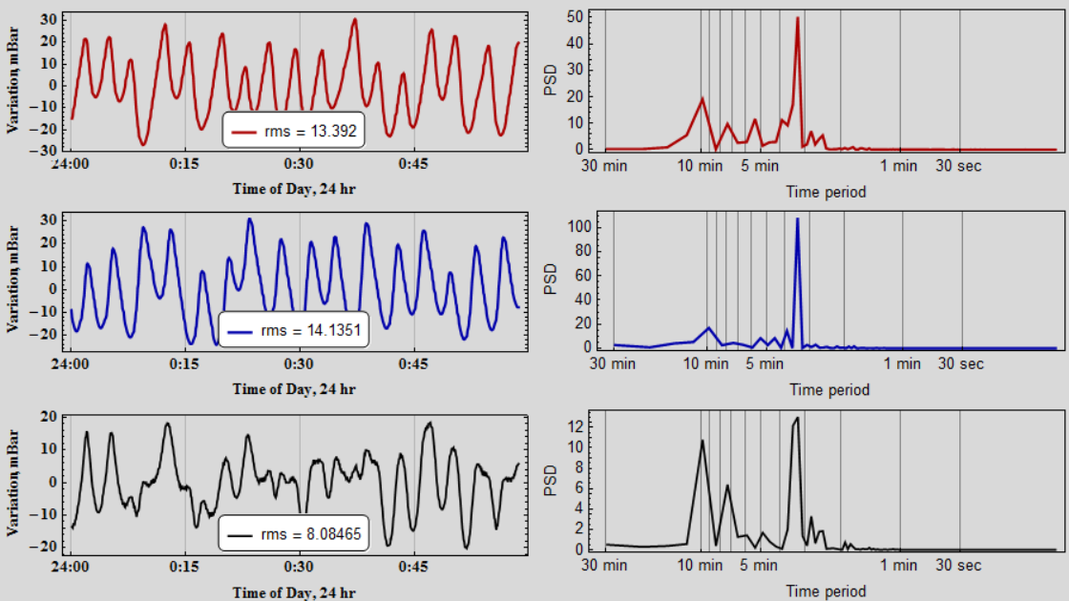
Add time delay between scans in opposite directions

Slide 17
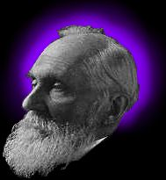
Acknowledgements
COLLABORATORS:
Gary P. Centers,^{1,2} Gevork Gevorkyan,¹ Sergey Nikitin,¹ Brian V. Smith,¹ and Valeriy V. Yashchuk¹, Dmitriy L. Voronov¹
PRIMARY FUNDING:
The Advanced Light Source is supported by the U. S. Department of Energy under contract number DE-AC02-05CH11231.
“To measure is to know.”
“If you can not measure it, you can not improve it.”
Sir William Thomson
(Lord Kelvin)

