Slide 1
Alphabet Soup No More! Revision of Standard Citation Forms
Valerie Buck
Brigham Young University
Marcia Barrett
University of California, Santa Cruz
Emily Epstein
University of Colorado Anshutz Medical Campus
55th RBMS Preconference
Las Vegas, Nevada
25 June 2014

Slide 2
SCF Revision Team Marcia Barrett (University of California, Santa Cruz), chair, 2011- Valerie Buck (Brigham Young University) Jane Carpenter (UCLA) Ellen Cordes (Yale University) Emily Epstein (University of Colorado Anshutz Medical Campus) Francis Lapka (Yale Center for British Art) Christine Megowan (St. Andrews University) Ann Myers (Stanford University)
Many thanks to:
Kelli Hansen, RBMS Web Team
Melissa Hubbard, RBMS Web Team
Notes:
We are presenting on behalf of our whole team, whose names you see here. We also wanted to especially thank these members of the Web Team for all their fantastic help.
In our outline of this presentation, I will present the background information about this project.
Marcia will present the new instructions for creating citation forms.
And Emily will show the citation forms in the MARC record as the public sees it, and then demonstrate the new Standard Citation Forms Database.

Slide 3
Citation for a Bibliography
Notes:
To begin with, I’m going to give you some context for what we’re doing.
Here we see a bookseller’s description of a monograph, which includes what may appear as a weird code. Experienced rare book people may know what it stands for. Many others will not.
What it is, is a shorthand citation for a reference source, a bibliography that describes this rare monograph. If a user doesn’t know this, they will not be guided back to the bibliography.
Our revision group was formed to see what we could do to make citation forms more easily traceable.

Slide 4
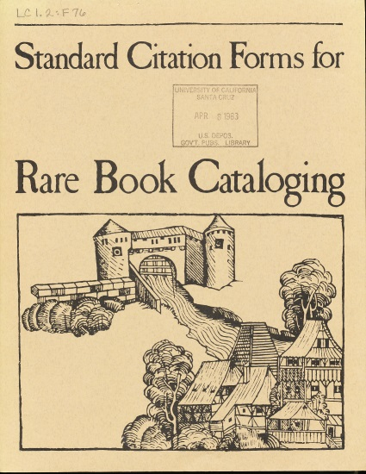
Standard Citation Forms History
1982 edition
2nd (1996) edition
Digitized 2nd (1996) edition
Notes:
In the past, the Library of Congress has published manuals that can help decipher the citation shorthand. These manuals were primarily produced to help rare book catalogers add citations to bibliographic records, but could be helpful to anyone. The 2nd ed., here, contains about 800 established citation forms that can help users either track down a shorthand citation, or be able to apply a shorthand citation themselves.
In the 1996 revision, the editors agreed not to create any new citations using a single surname, but left alone those that had already been created this way.
Around 2008, Barbara Tillet, Elizabeth Robinson, and Debora J. Leslie proposed that in a revised manual, the citations be formed using the main entry and an unabbreviated title proper from the bibliographic record, and to revise only the citations affected by this principle.
However, once the test group started working, they decided to revise ALL entries to make the cited resources more easily findable and consistent.
The main goal in revising Standard Citation Forms is to get users to the resource. In the past the shorthand was a necessary compromise because it saved valuable time and money. But in the electronic age it is no longer necessary.

Slide 5
Expanded Scope & Audience
Catalogers
Curators
Booksellers
Scholars
Other users of the catalog
Notes:
Our revision group worked to expand the revision to include a broader scope of bibliographies covering all rare materials, not just rare books.
The new database – in place of a printed 3rd ed. – is not limited only to bibliographies from the national level, but can include those from local levels
The database is open to ANY bibliography that might be helpful to rare materials cataloging.
This means it can also include any bibliography for a single author.
We also wanted to broaden our audience to include people new to the rare book world, as well as others coming from different purposes and backgrounds … [slide]
You see here an example of a surname-only citation. [2nd 510]
We worked to come up with principles that better guide a user to a resource [more like 3rd 510].

Slide 6
Principles
The bibliographic record
Intelligibility
Simplicity
Consistency
Inclusiveness
Notes:
As the revision group developed the new principles for forming citations, we considered the following:
We took the information for the citation from the bibliographic record of the bibliography.
We wanted the citation form to be intelligible (so include enough information), but also as simple as possible, and as consistent as possible from one citation to the next.
We wanted to make sure that the resulting form was decipherable by all, not merely by experienced “insiders”.
I’ve changed the 2nd 510 from the previous slide to this new citation form according to these principles.
Explain: Purpose of the principles
“Marcia will get into the principles themselves”

Slide 7
Alignment with RDA
Differentiation
Sufficiency
Representation
Relationships
Notes:
RDA (Resource Description & Access) is the current cataloging standard, implemented in the last couple of years to help cataloging meet the needs of the electronic age. One of the main principles of RDA is the eradication of cataloger-supplied abbreviations and acronyms in bibliographic records (to decrease potential user confusion, to be more user-friendly).
Our revision group grappled with how to come into alignment with RDA.
In cases where a book and its supplement, for example, shared the same title, we knew that we needed to differentiate their citations in order to lead a user to the correct resource.
Aligning with RDA, we spelled out cataloger-supplied qualifiers.
--we wanted to make sure the citation forms supplied sufficient information to guide users back to the appropriate resource
--we used the bibliographic record to represent the bibliography as we created the citation forms. We did not always have the resource in hand, and besides, we knew it was beyond our scope to recatalog all bibliographies accdg to RDA. So we used bibliographic records as we found them in OCLC Worldcat, most of which are cataloged according to AACR2.
Another main principle of RDA is the better showing of relationships between authors and the works, and works to works, etc. The purpose of our revision is NOT to show relationships. We leave this to the bibliographic record. Our main goal, as stated before, is to guide the user to the bibliographic resource.
Now Marcia will explain the new instructions for creating citation forms.

Slide 8
Citation Forms in 2nd Edition
Acronyms
BAL
Multiple surnames
Dichter & Shapiro
Surname only
Evans
Abbreviations
Romaine, L.B. Amer. trade cats.
Illustration by Debbie Ridpath Ohi
Notes:
Those familiar with established citation forms will recognize these conventions for abbreviating citations.

Slide 9
Citation Forms in 2nd Edition
Abbreviated title information
Cioranescu, A. 18. s.
Truncated title information
Rochedieu, C.A.E. French translations
Based on name other than main entry
George
Based on original work, not work cited
Sander (suppl.)
Notes:
The new edition of Standard Citation Forms will not include any of these conventions used in earlier editions.

Slide 10
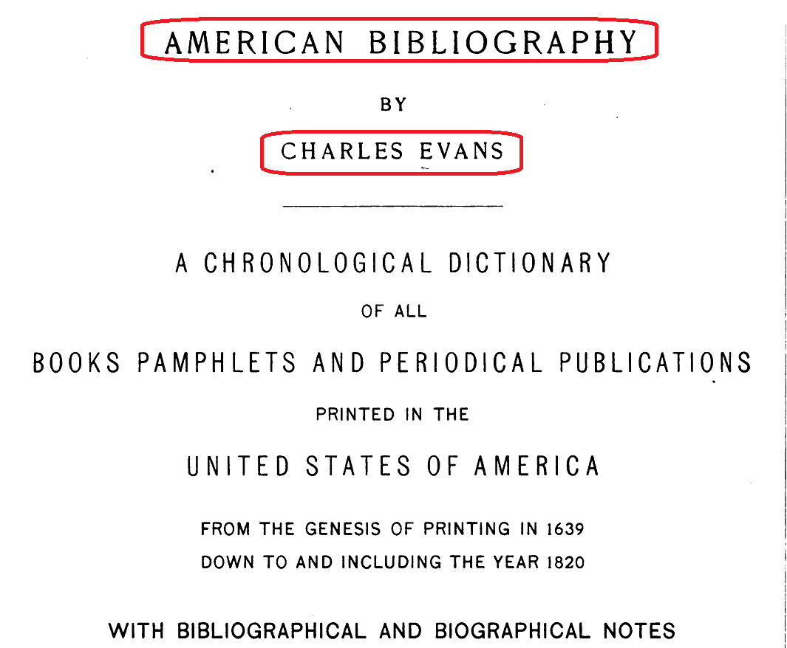
New Citation Forms: Name. Title
Evans
Evans, C. American bibliography
Notes:
New citation forms will be based on the name entry and title proper.
This is a scan of the title page for Charles Evans’ American bibliography. What previously was “Evans” becomes “Evans, C. American bibliography.”
In addition to formulating working principles and instructions for creating citation forms, the team has revised all of the citation forms that were included in the 2nd edition.

Slide 11
Old / New SCF
BAL
Blanck, J. Bibliography of American literature
Evans
Evans, C. American bibliography
Dichter & Shapiro
Dichter, H. Early American sheet music
Notes:
These next two slides show revisions of the examples that demonstrated conventions of previous editions of standard citation forms, “before and after.”
BAL becomes “Blanck, J. Bibliography of American literature”
The citation form “Dichter & Shapiro” which was based on two co-authors is changed to a name/title form, based on the main entry or in RDA terminology, the authorized access point.

Slide 12
Old / New SCF
Romaine, L.B. Amer. trade cats.
Romaine, L.B. Guide to American trade catalogs, 1744-1900
Cioranescu, A. 18. s.
Cioranescu, A. Bibliographie de la littérature française du dix-huitième siècle.
Rochedieu, C.A.E. French translations
Rochedieu, C.A. Bibliography of French translations of English works, 1700-1800
Notes:
These examples show previous forms that were greatly abbreviated.
The new citation form includes the surname, forename initials, and complete title proper.

Slide 13
Old / New SCF
George
Catalogue of prints and drawings in the British Museum
Sander (suppl.)
Rava, C.E. Supplément à Max Sander
Notes:
These examples show previous citation forms that were not based on the main entry (or authorized access point) for the work.
The citation formerly known as “George” is now based on corporate body main entry, and the citation formerly known as the Sander supplement is now based on the work cited.

Slide 14
Old / New SCF
Many citation forms will not change
Rink, E. Technical Americana
Rogal, S.J. Children’s jubilee
Some new citation forms will be longer:
Cockle, M.J.D. Military books
Cockle, M.J.D. Bibliography of English military books
up to 1642 and of contemporary foreign works
Notes:
Although many citation forms – those that were abbreviated or not based on the work cited – will change with the new edition, many – those that were based on author/title entry -- will remain the same.
Because abbreviations have been eliminated, some new citation forms will be longer.
The SCF Revision Team experimented with truncating the title proper, but because team members had varying ideas as to how much of the title proper to include, the results moved away from a standard citation form.

Slide 15
Instructions for Creating SCF
Notes:
Emily is going to talk more about the SCF database. I do want to point out that the database includes instructions for creating citation forms along with examples. These can be found in the Working Principles section.
The Introduction includes history and other information that Valerie covered.

Slide 16
Instructions for New SCF
Name. Title proper
Name
Personal – Surname, forename initial(s)
Corporate – Subordinate body when needed for retrieval
Drop when included in the title
Title Proper
Exclude initial articles, part/alternative/parallel titles
Notes:
Here is a summary of the basic instructions for creating a citation form.
The citation is based on name/title proper entry.
For the name portion of the citation, basis of the name is the Library of Congress Name Authority record.
For personal name entry, include the surname and forename initials.
For corporate name entry, include the subordinate body only when needed for retrieval.
For both, the name is dropped when it is repeated in the title proper.
For the title portion, initial articles, part titles, alternative titles, and parallel titles are excluded from the title proper.

Slide 17
Examples: Personal Name Entry
Drake, Milton. Almanacs of the United States
Drake, M. Almanacs
Drake, M. Almanacs of the United States
Frank, F.S. Through the pale door: a guide to and through the American gothic.
Frank, F.S. Gothic
Frank, F.S. Through the pale door
Carter, Harry Graham. Civilité types.
Carter & Vervliet
Carter, H.G. Civilité types
Notes:
These are examples of works entered under personal name.
The blue font shows name and title proper of the bibliographic information so that you can see the basis for the citation form.
The lined through examples show the previous citation form.
The bold examples show the new citation form.
A user should be able to locate a catalog record for the work cited, based on the information in the new citation form.

Slide 18
Examples: Corporate Body Main Entry
Harvard College Library. Dept. of Printing and Graphic Arts. Sixteenth-century architectural books from Italy and France: [exhibition].
Harvard College Library. Sixteenth-century
architectural books from Italy and France
Cambridge University Library. A catalogue of the fifteenth-century printed books in the University Library, Cambridge. Compiled by J.C.T. Oates.
Oates
Catalogue of the fifteenth-century printed
books in the University Library, Cambridge.
Notes:
These are examples of works entered under corporate body.
Again, the citation form is based on a name/title entry.
The first example shows that the subordinate name of the corporate body is not included in the citation form because it is not needed for retrieval.
The second example shows that the corporate body name can be dropped from the citation form because the name is repeated in the title.
The second example is one that was previously cited by compiler.

Slide 19
Examples: Title Entry
The New Cambridge bibliography of English literature
NCBEL
New Cambridge bibliography of English
literature
The National union catalog, pre-1956 imprints: a cumulative author list representing Library of Congress printed cards and titles reported by other American libraries.
NUC pre-1956
National union catalog, pre-1956 imprints
Notes:
These are examples of works entered under title. The new citation form is straightforward – it’s the title proper.

Slide 20
Instructions for New SCF
Base the citation on the bibliographic record
To distinguish between similar titles:
Transcribe (just enough) part title / other title information
Supply edition information
Supply term to identify supplement
Notes:
The citation form is always based on the bibliographic record for the work cited.
In most cases, name/title is sufficient for a citation form.
In some cases, additional information is needed to distinguish between what would otherwise be identical or similar citation forms.
The instructions for providing additional information are ….
Transcribe (just enough) part title / other title information
Supply edition information
Supply term to identify supplement

Slide 21
Part Title Information
Crawford, J.L.L. Bibliotheca Lindesiana. Catalogue of a collection of English ballads of the XVIIth and XVIIIth centuries, printed for the most part in black letter.
Crawford, J.L.L. Bibliotheca Lindesiana.
Catalogue of a collection of English ballads
Crawford, J.L.L. Bibliotheca Lindesiana. Catalogue of English broadsides, 1505-1897.
Crawford, J.L.L. Bibliotheca Lindesiana.
Catalogue of English broadsides
Notes:
This slide shows examples of citation forms that would be identical without the addition of part title information.
In this case, we transcribe enough of part title to distinguish between the citations.

Slide 22
Other Title Information
Arents, George. Tobacco: its history illustrated by the books, manuscripts, and engravings in the library of George Arents, Jr., together with an introductory essay, a glossary, and bibliographic notes by Jerome E. Brooks.
Arents, G. Tobacco: its history
Arents Tobacco Collection. Tobacco: a catalogue of the books, manuscripts, and engravings acquired since 1942 in the Arents Tobacco Collection at the New York Public Library, from 1507 to the present.
Arents Tobacco Collection. Tobacco: a
catalogue
Notes:
As with part titles, other title information is transcribed to the extent necessary to distinguish between otherwise identical or similar citation forms.
In this example, the title proper of the two works is identical, and the addition of some other title information increases the likelihood of finding and identifying a bibliographic record for the work cited.

Slide 23
Multiple Editions
Vicaire, Georges. Bibliographie gastronomique: la cuisine, la table, l'office, les aliments, les vins, les cuisiniers et les cuisinières … Paris: P. Rouquette et fils, 1890.
Vicaire, G. Bibliographie gastronomique
Vicaire, Georges. Bibliographie gastronomique: a bibliography of books appertaining to food … from the beginning of printing to 1890. 2nd ed. London: D. Verschoyle, Academic and Bibliographical Publications, 1954.
Vicaire, G. Bibliographie gastronomique (2nd ed.)
Notes:
Edition information is added to citation forms that would otherwise be identical or very similar.
Instructions are to supply edition information, using the language of the bibliographic record.
Many of the examples that you will see are taken from bibliographic records based on AACR2 cataloging, and that is why the edition information is abbreviated.
Edition information is supplied to the extent necessary to distinguish citations. For example, if an edition statement in a bibliographic record read “2nd edition, greatly enlarged and revised,” only (2nd edition) would be included as part of the citation form.
For edition statements that are not numbered or dated, supply the publication date with the term edition.

Slide 24
Multiple Editions
Vicaire, Georges. Bibliographie gastronomique: la cuisine, la table, l'office, les aliments, les vins, les cuisiniers et les cuisinières, les gourmands et les gastronomes, … Paris: P. Rouquette et fils, 1890.
Vicaire, G. Bibliographie gastronomique
1978 reprint of the 1890 edition with identical title (columns numbered differently – treat as a different edition)
Vicaire, G. Bibliographie gastronomique (1978
edition)
Notes:
This example shows supplied edition information for a work without a numbered or dated edition statement.
We are treating reprints with different numbering or additional information as new editions, so the 1978 version of this work is considered a new edition.

Slide 25
Multiple Editions
Gaines, Pierce Welch. Political works of concealed authorship during the administrations of Washington, Adams, and Jefferson, 1789-1809, with attributions.
Gaines, P.W. Political works of concealed authorship
during the administrations of Washington, Adams, and
Jefferson, 1789-1809
Gaines, Pierce Welch. Political works of concealed authorship in the United States, 1789-1810: with attributions. Rev. and enl. ed. Note: previous edition has different title
Gaines, P.W. Political works of concealed authorship
in the United States, 1789-1810
Notes:
It is necessary to supply edition information only in cases where a citation would otherwise be identical or similar to the citation form for another work.
In this example, the 2nd edition was published under a different title, so no edition information is supplied with the citation form.

Slide 26
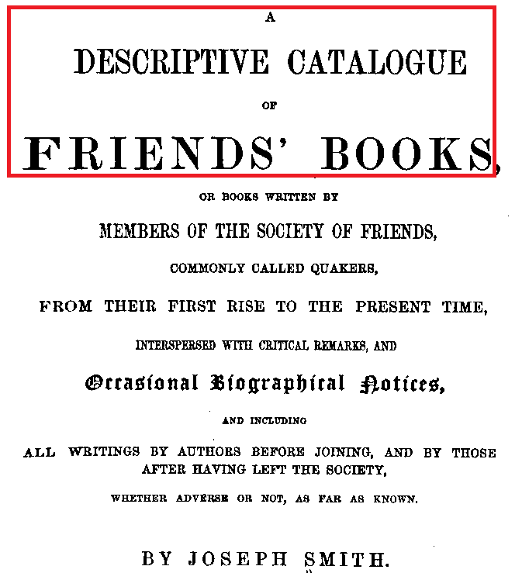
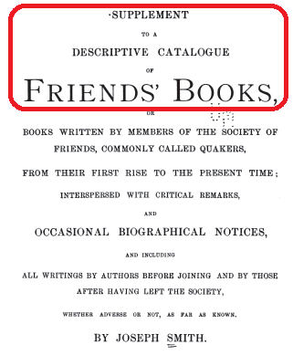
Smith, J. Descriptive catalogue of friends’ books
Smith, J. Supplement to a descriptive catalogue of friends’ books
Notes:
As the previous example demonstrated, it won’t always be necessary to supply additional information for later editions or supplemental works.
The name/title entry may result in a citation that is unique and sufficient to get a user to a bibliographic record for the work, as in this example of the Supplement to a descriptive catalogue of friends’ books.

Slide 27
Supplements
Ferguson, John Alexander. Bibliography of Australia.
Ferguson, J.A. Bibliography of Australia
Monash University. Library. The Monash University Library supplement to John Alexander Ferguson's Bibliography of Australia.
Monash University Library supplement to John
Alexander Ferguson’s Bibliography of Australia
Notes:
Citations for supplements are based on a name/title entry. This example shows a supplement published under a unique title, resulting in a citation form that is distinctive from the citation for the original work.

Slide 28
Supplements
Flake, Chad J. A Mormon bibliography, 1830-1930: books, pamphlets, periodicals, and broadsides relating to the first century of Mormonism.
Flake, C.J. Mormon bibliography, 1830-1930
Flake, Chad J. Mormon bibliography, 1830-1930. Ten year supplement
Flake, C.J. Mormon bibliography, 1830-1930
(supplement)
Notes:
Supplement information is supplied for citation forms that would otherwise be identical or similar to citations for the original work. Instructions are to supply a term from the title information as stated in the bibliographic record.
As with supplying edition information, give only enough information to distinguish the citations.
In this example, the addition of (supplement) is enough to get a user to the bibliographic record for the supplementary work.

Slide 29
Supplements
Flake, Chad J. A Mormon bibliography, 1830-1930: books, pamphlets, periodicals, and broadsides relating to the first century of Mormonism.
Flake, C.J. Mormon bibliography, 1830-1930
Flake, Chad J. A Mormon bibliography, 1830-1930. Indexes to A Mormon bibliography and Ten year supplement.
Flake, C.J. Mormon bibliography, 1830-1930
(indexes)
Notes:
In this example, the addition of (indexes) is enough information to get a user to a bibliographic record for the work.
Now, Emily will demonstrate the interface and functionality for the Standard Citation Forms database.

Slide 30
Old Citation Forms - Public Display
(Stanford University Library catalog via WorldCat)

Slide 31
New Citation Forms - Public Display
(University of Colorado Health Sciences Library catalog)

Slide 32
Search - Author, Title, Citation #, Old Form, and Keyword

Slide 33
Author Search

Slide 34
Title Search

Slide 35
Keyword Search (includes subject headings)

Slide 36
Previous Citation Form Search

Slide 37
New Functionality
Link to record in WorldCat

Slide 38
New Functionality
Link to full text (when available)

Slide 39
Publication Plans
The task force will be asking for final approval of the document at ALA Summer Conference 2014.
When it is published, the Standard Citation Forms for Rare Materials database will be hosted on the RBMS website.
A publicly available not-yet-approved version database is currently available at: http://www.rbms.info/scfsandbox/

