Slide 1
Curation is Not a Place Post-Custodial Stewardship for a Do-It-Yourself World
DLF 2017 Forum
Pittsburgh, 23-25 October 2017
Stephen Abrams
California Digital Library
0000-0003-2326-6672
@slabrams

Slide 2
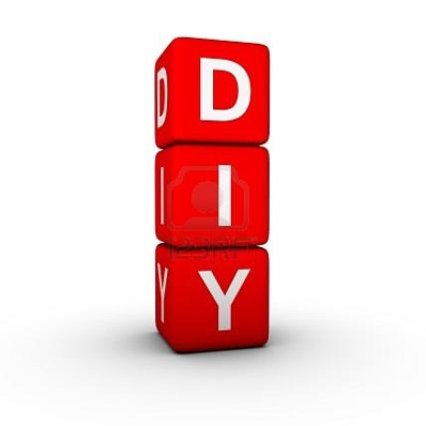
The world has changed
thecoffeeclubandme.wordpress.com/tag/do-it-yourself/
Notes:
Tworld in which libraries and other memory institutions operate has changed in a very real, dramatic, and fundamental way.
https://thecoffeeclubandme.wordpress.com/tag/do-it-yourself/

Slide 3
It’s a do-it-yourself world
Stakeholders who used to have to work with us in the past to acquire, manage, and present content now have lots of options to do things for themselves
… and often to do it for free

Slide 4
We can’t keep content locked up anymore
pixabay.com/p-145284/
Notes:
https://pixabay.com/p-145284/

Slide 5
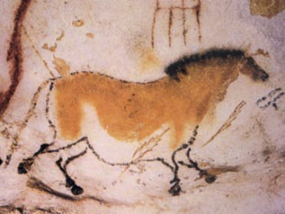
What is our unique value proposition?
Expertise, a commitment to the cultural record for its own sake, and a long time horizon
commons.wikimedia.org/wiki/File:Lascaux2.jpg
Notes:
So how do we maintain our relevance in a do-it-yourself world? I think we need to play towards our strengths: unique expertise in stewardship, a commitment to the scholarly and cultural record for its own sake (not commercial gain), and a very long time horizon.
Cave painting of a dun horse (equine) at Lascaux, https://commons.wikimedia.org/wiki/File:Lascaux2.jpg

Slide 6
Let’s worry about services, not systems
But these do not have to be dependent upon physical possession of the resources to which the services are applied
www.flickr.com/photos/pictoquotes/25738238981
Notes:
So let’s worry about added-value services, not systems.
Lao Tzu To hold, you must first open your hand. Let go, https://www.flickr.com/photos/pictoquotes/25738238981

Slide 7
Post-custodial archives
“What will recordkeeping and archiving processes be like when the location of the material matters less than its accessibility, when records no longer have to move across clear boundaries in space or time to be seen as part of an archives?”
– Frank Upward (2000) <doi.org/10.1108/EUM0000000007259>
Notes:
Frank Upward, (2000) "Modelling the continuum as paradigm shift in recordkeeping and archiving processes, and beyond – A personal reflection", Records Management Journal 10.3: 115-139, https://doi.org/10.1108/EUM0000000007259

Slide 8
The ejournal literature is post-custodial
We point patrons to content hosted elsewhere
Preservation is outsourced …
but to trusted entities
Is the importance of that trust magnified because we’re asked to trust so few?
Notes:
Preservation is outsourced, but we justify that by dealing with trustworthy parties.

Slide 9
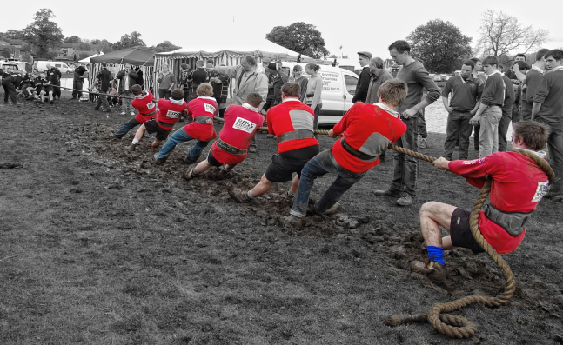
Trust in competence vs. trust in numbers
If you can coordinate enough local copies, no matter how unstable or ephemeral, can you nevertheless achieve desirable global reliability and persistence?
www.flickr.com/photos/tjblackwell/3545764529
Notes:
Tom Blackwell, Tug of war – colour edit, https://www.flickr.com/photos/tjblackwell/3545764529

Slide 10
Post-custodial stewardship
Knowing where all the copies are is more important than having a copy
www.flickr.com/photos/mil8/380101976
Notes:
Marc Levin, Pushpins in a map over the U.S.A, https://www.flickr.com/photos/mil8/380101976

Slide 11
Post-custodial remote control
A combination of registry and repository function
A unified curatorial interface and service environment applicable to remote and local content
Notes:
Do we have a solution? Of course not, or I wouldn’t be presenting in this snapshot session. But it’s an idea we’re very committed to and have started investigating.

Slide 12
Co-option and an appropriate division of labor
Turning (unassailable) competitors into (unwitting) collaborators
goo.gl/images/eFHsc7
Notes:
https://goo.gl/images/eFHsc7

Slide 13
Spooky action at a distance
Remote read/write permission, but not necessarily exclusive permission
Aggressive monitoring and automated policy enforcement
Explicit agreement on stewardship intentions and customer expectations
www.pexels.com/photo/agree-agreement-ankreuzen-arrangement-210585/
Notes:
https://www.pexels.com/photo/agree-agreement-ankreuzen-arrangement-210585/

Slide 14
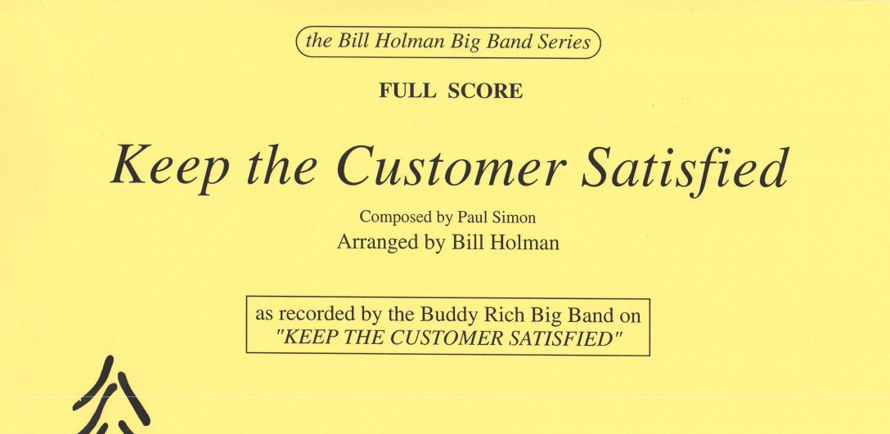
Extending reach and impact by yielding control
Drive up adoption and retention, and maintain relevance by providing necessary services at the place where they are already working
marinamusic.com/wp-content/uploads/2013/04/A1145.gif
Notes:
https://marinamusic.com/wp-content/uploads/2013/04/A1145.gif

Slide 15
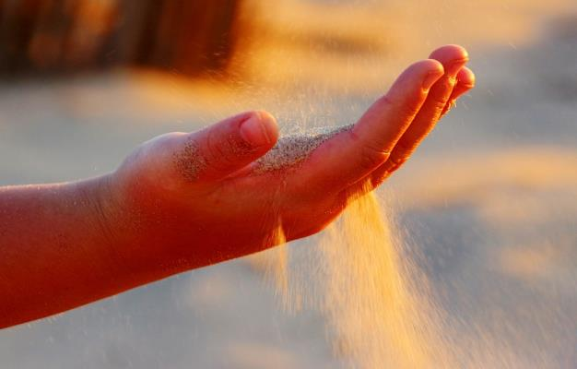
Curation is Not a Place
Post-Custodial Stewardship for a Do-It-Yourself World
Stephen Abrams
Stephen.Abrams@ucop.edu
@slabrams
UC Curation Center
California Digital Library
uc3.cdlib.org
uc3@ucop.edu
maxpixel.freegreatpicture.com/Finger-Open-Rippling-Sand-Sand-Hand-1599898
Notes:
http://maxpixel.freegreatpicture.com/Finger-Open-Rippling-Sand-Sand-Hand-1599898

